Slide 1
Software and systems engineering
Paulo Borba
Informatics Center
Federal University of Pernambuco
phmb@cin.ufpe.br ◈ twitter.com/pauloborba

Slide 2
To do before class
Watch video
Read related part of chapter 10 in the textbook
Send questions and opinions through slack

Slide 3
Software and systems engineering
Paulo Borba
Informatics Center
Federal University of Pernambuco
phmb@cin.ufpe.br ◈ twitter.com/pauloborba

Slide 4
Configuration management 1,
basic concepts and operations

Slide 5
Software and system development is often done in teams!

Slide 6
Team members contribute to the same artifacts

Slide 7
Productivity and quality problems sharing requirements, source code, etc. via...
email
dropbox
google docs

Slide 8
Source code (artifact) control systems

Slide 9
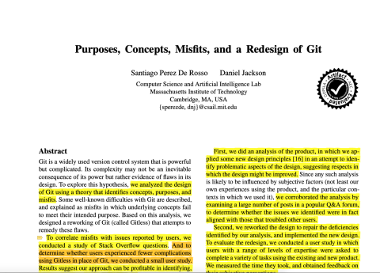
Version Control purposes (De Rosso & Jackson)
Data management: make a set of changes persistent
Change management: group logically related changes, record coherent points
Collaboration: synchronise changes
Parallel development: isolated lines of development
Disconnected operation
Notes:
Which of these are not supported by google docs?
Purposes, Concepts, Misﬁts, and a Redesign of Git. Santiago Perez De Rosso and Daniel Jackson. OOPSLA 2016.

Slide 10


Slide 11
Results
Identifies git purposes, concepts, and some misfits (design flaws)
Proposes gitless to solve the misfits
Brings evidence that the misfits negatively impact developers (by mining related StackOverflow questions)
Brings inconclusive evidence (experiment + survey with 11 researchers) that gitless might help people to complete tasks quickly

Slide 12
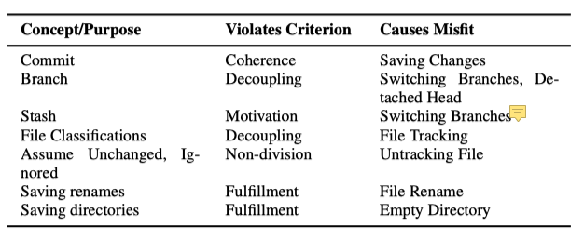

Slide 13
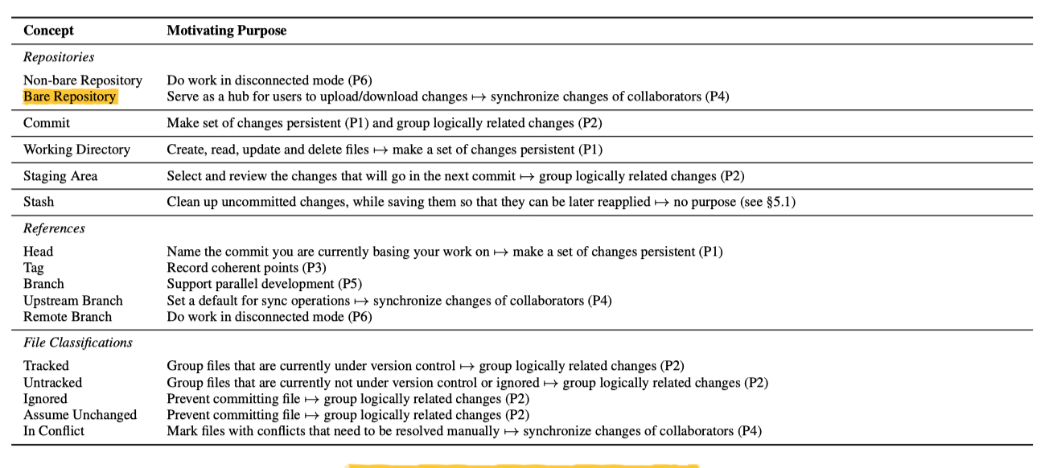

Slide 14
Overview of main concepts

Slide 15
Creating a local repository

Slide 16
From scratch

Slide 17
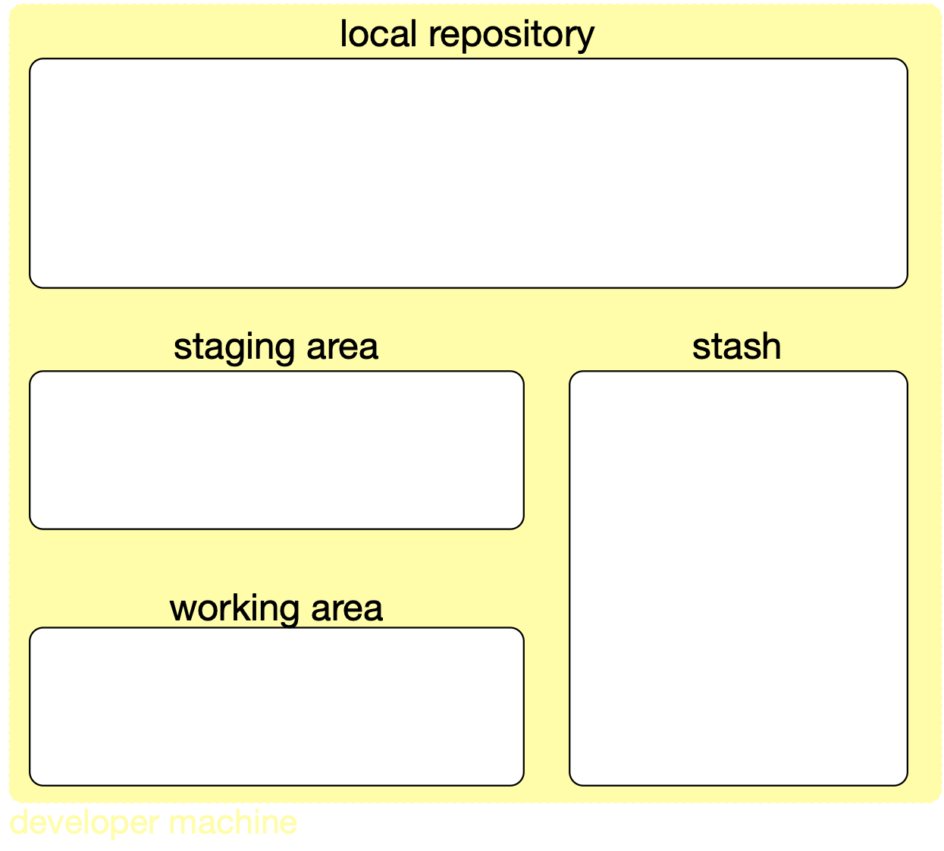

git init

Slide 18
From an existing repository

Slide 19
git clone

Slide 20
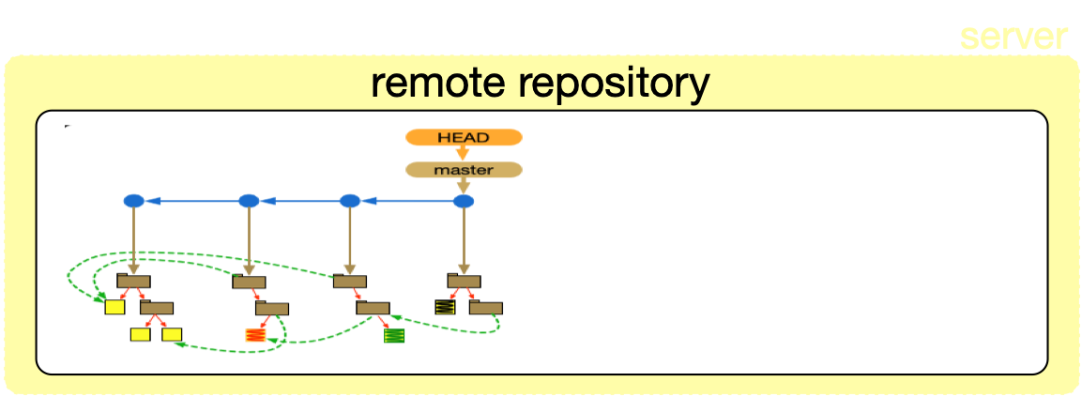
project history
Notes:
poderia ser local também

Slide 21
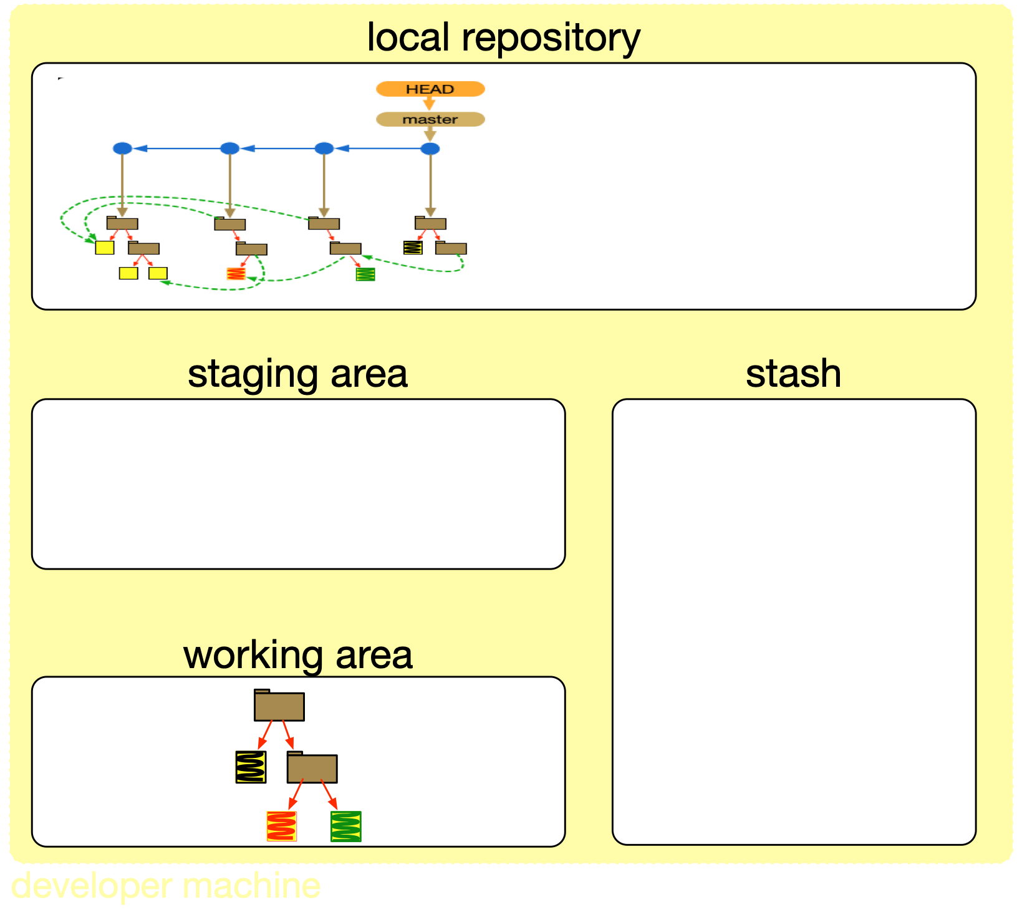
files and folders pointed by HEAD

Slide 22
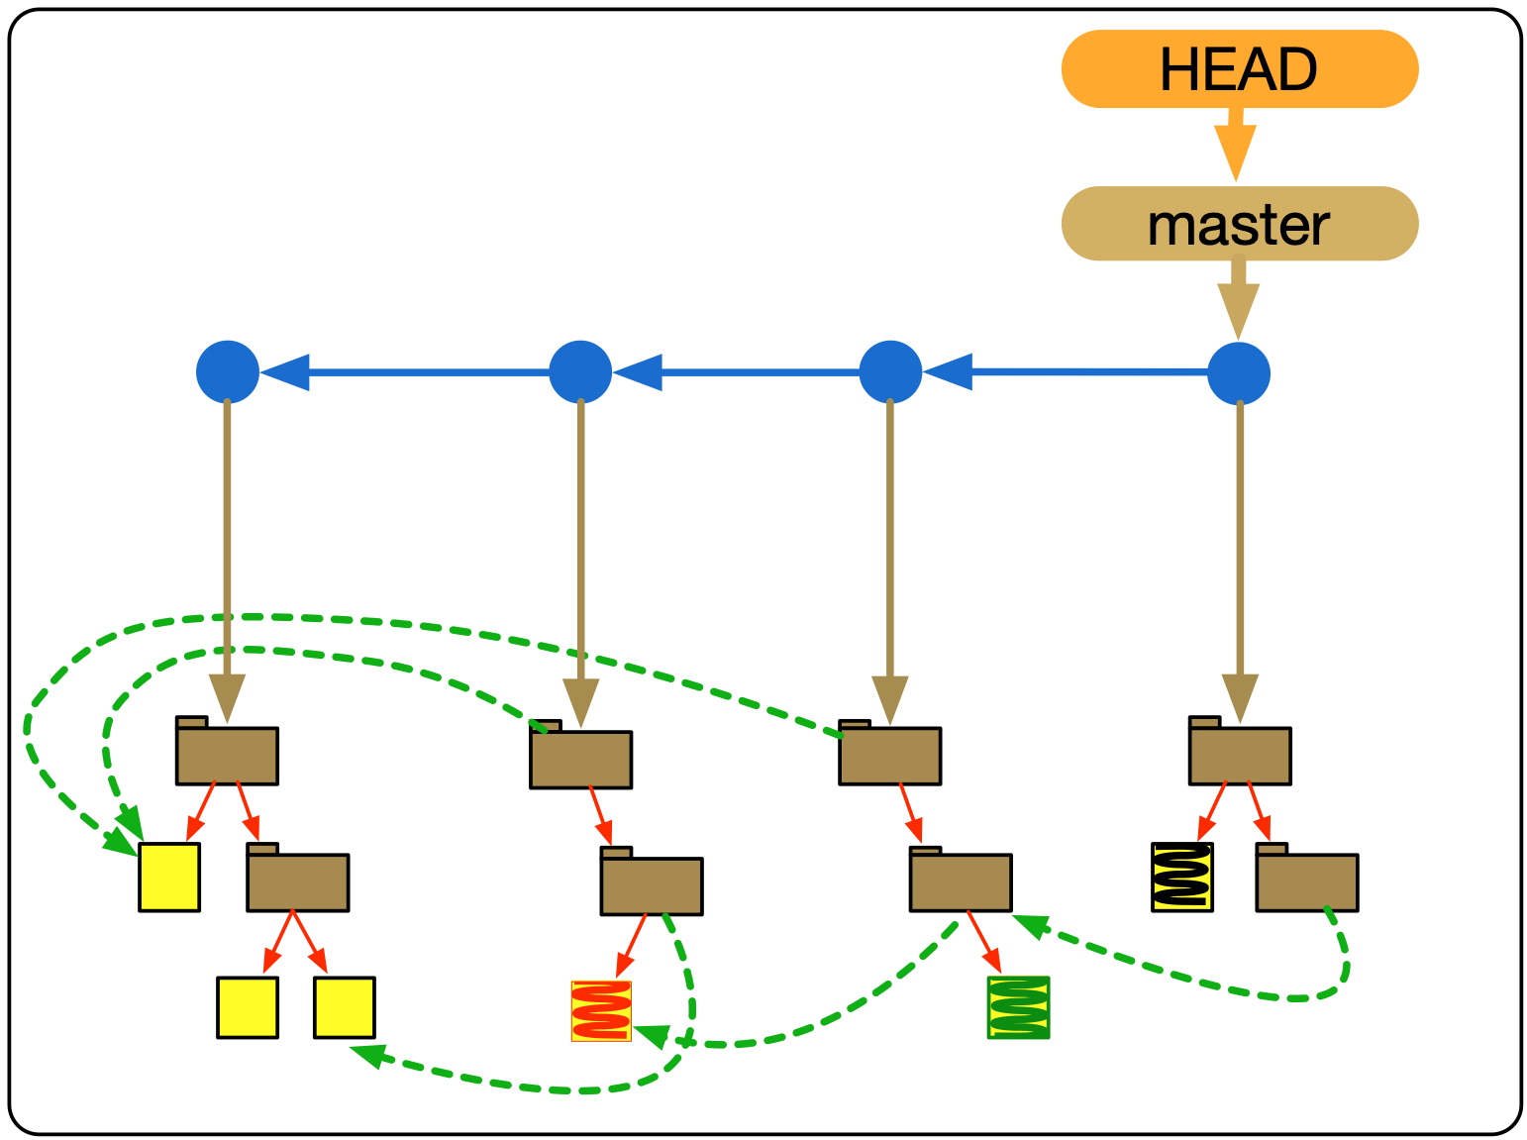
Commit graph
pointers
commits
named pointers
folders
files
Notes:
explicar todos os tipos de ponteiros
pode ser visto usando git log https://www.git-scm.com/docs/git-log

Slide 23
Persisting and recording changes

Slide 24
Locally changing files

Slide 26
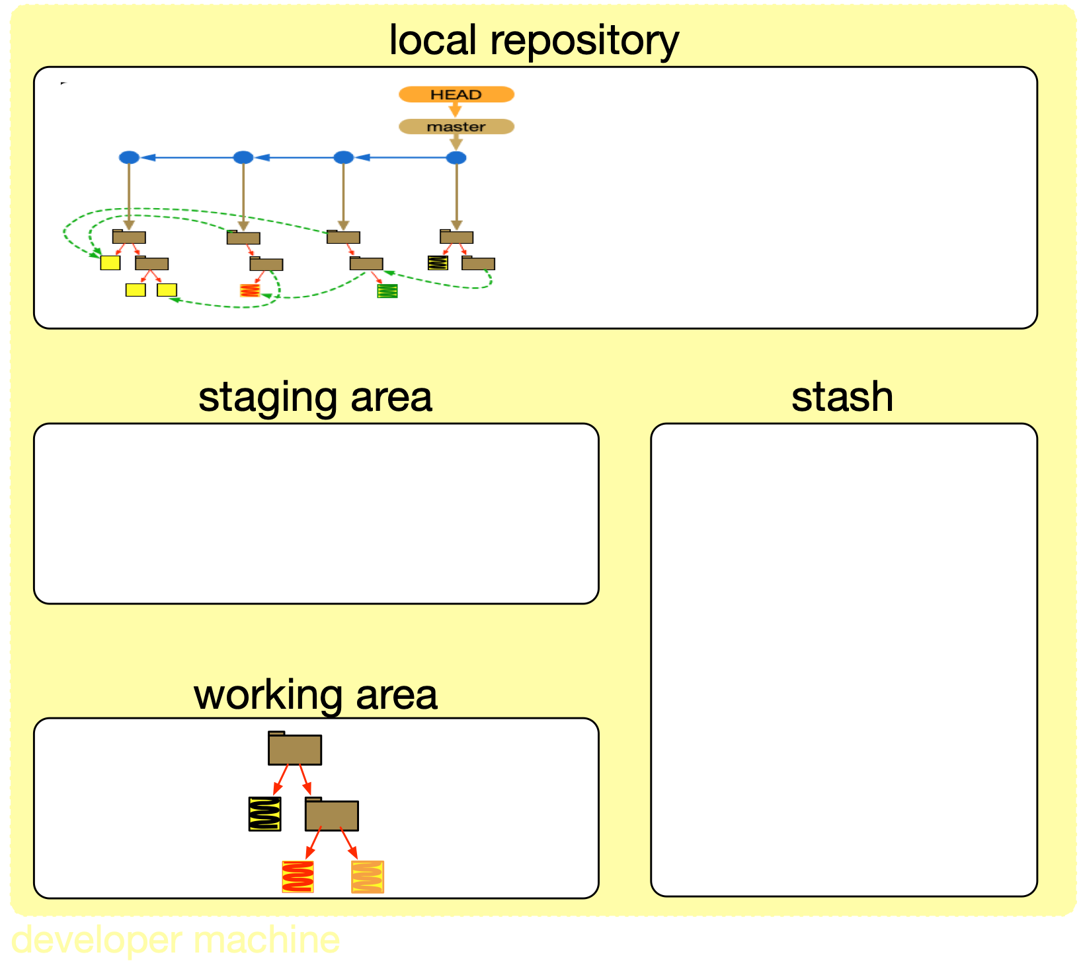

Slide 27
git add
indicating that files are of interest
Notes:
https://git-scm.com/docs/git-add
--interactive
Add modified contents in the working tree interactively to the index. Optional path arguments may be supplied to limit operation to a subset of the working tree. See “Interactive mode” for details.

Slide 29
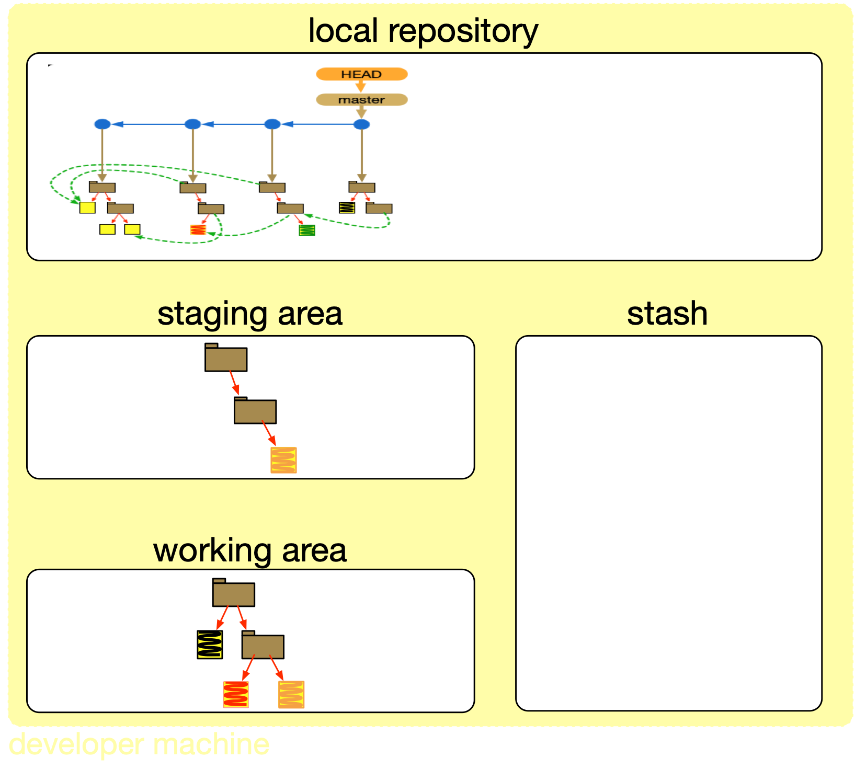

Slide 30
atualizar arquivo anteriormente colocado no stage, mudança recente vai pro commit ou nao?
tem que dar add de novo, ou dar commit com -a

Slide 31
git commit
recording changes

Slide 33
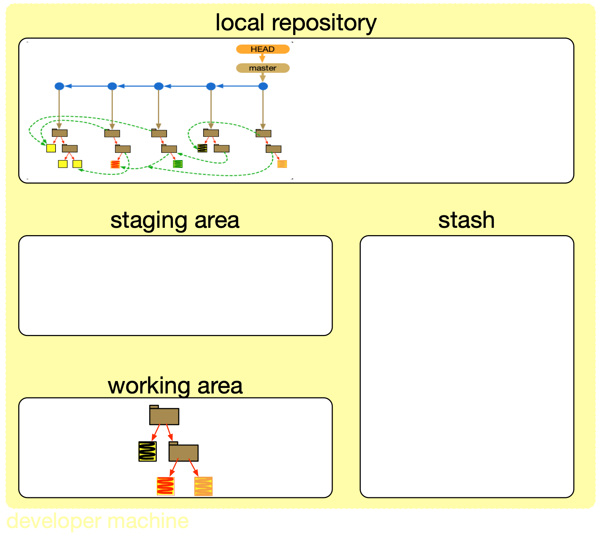

Slide 34

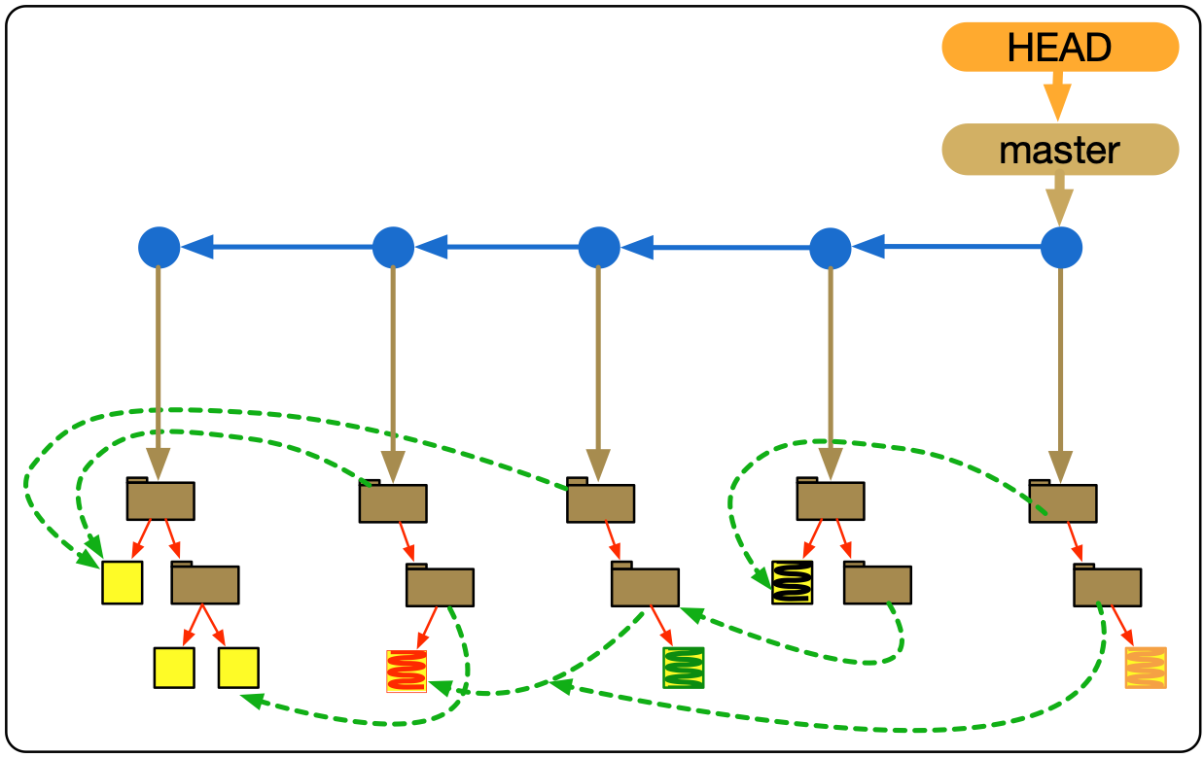
named pointers are updated

Slide 35
Could select subset of changes that are in the stage area
Notes:
https://git-scm.com/docs/git-commit
by using the --interactive or --patch switches with the commit command to decide one by one which files or hunks should be part of the commit in addition to contents in the index, before finalizing the operation. See the “Interactive Mode” section of git-add[1] to learn how to operate these modes.
--amend
Replace the tip of the current branch by creating a new commit. The recorded tree is prepared as usual (including the effect of the -i and -o options and explicit pathspec), and the message from the original commit is used as the starting point, instead of an empty message, when no other message is specified from the command line via options such as -m, -F, -c, etc. The new commit has the same parents and author as the current one (the --reset-author option can countermand this).
It is a rough equivalent for:
$ git reset --soft HEAD^
$ ... do something else to come up with the right tree ...
$ git commit -c ORIG_HEAD
but can be used to amend a merge commit.
You should understand the implications of rewriting history if you amend a commit that has already been published. (See the "RECOVERING FROM UPSTREAM REBASE" section in git-rebase[1].)

Slide 36
git commit -a
combining commands

Slide 39
Collaborating

Slide 40
At creation time, local and remote commit histories are identical

Slide 42
But history might have evolved in the local repository

Slide 43


Slide 44
git push
sending changes to a remote repository

Slide 46
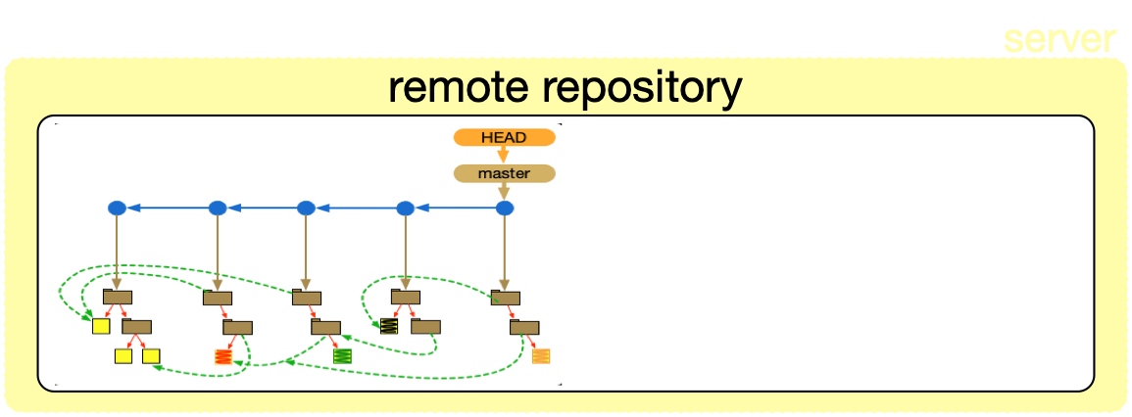

Slide 47
But history might have evolved in the remote repository
Notes:
only possible because someone else evolved locally and pushed to a remote repository

Slide 49
git pull
getting changes from a remote repository
Notes:
difference entre pull e fetch

Slide 52
When you don’t have write access to the remote repository…

Slide 53
Create your own remote repository, a fork

Slide 54
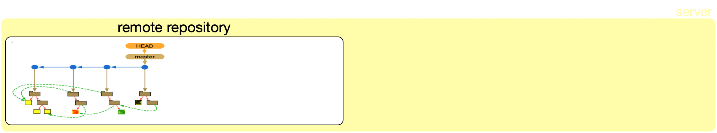
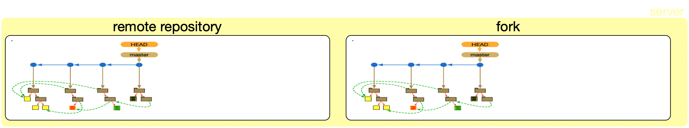

Slide 55
Push to fork
Create and send Pull Request
(from fork to remote)

Slide 56
Pull request collaboration model

Slide 57
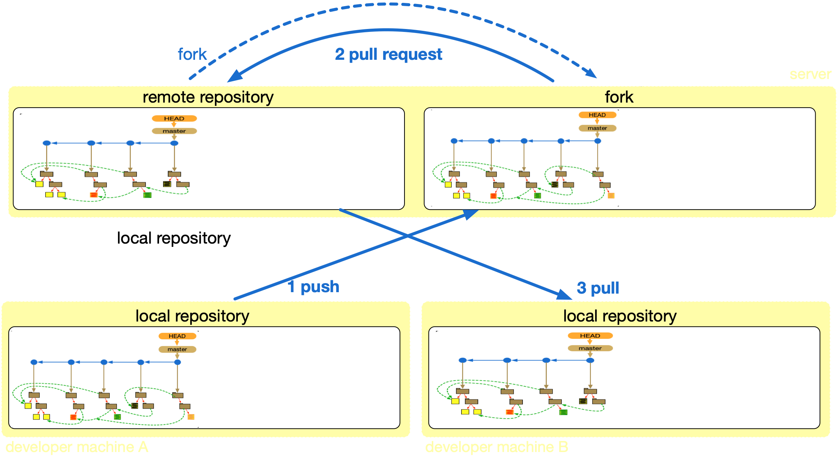
Notes:
ilustrar situação em que A tenta dar push mas está atrasado. B deu push antes.

Slide 58
Take notes, now!

Slide 59
Hands on exercises
Notes:
Indo de aluno por aluno, verificando o progresso, e registrando como comentário no assignment do classroom.

Slide 60
Configuration management 1,
basic concepts and operations

Slide 61
Configuration management 2, advanced concepts and operations

Slide 62
What if the changes you are making are tentative or risky?
And you don’t want to compromise other tasks and developers
Notes:
like trying to replace an existing API for a new one

Slide 63
Supporting independent (parallel) development

Slide 64
Naturally supported with local repositories

Slide 65
Notes:
na medida que dá o push (para master) pode comprometer o trabalho dos outros

Slide 66
But can we also support independence locally?

Slide 67
git branch
branches as pointers
multiple development lines

Slide 68
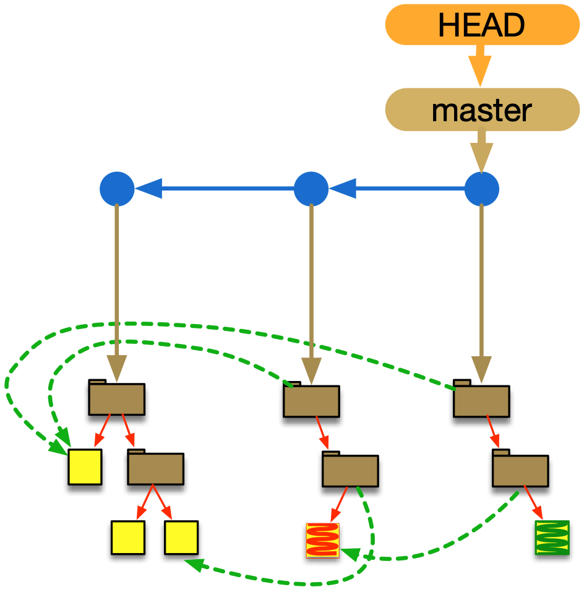

Slide 69
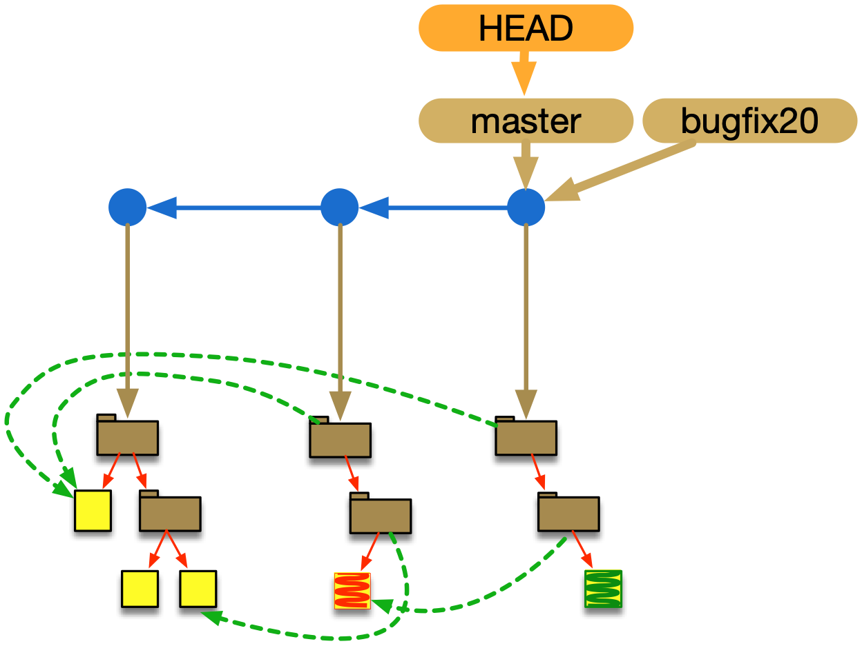

Slide 70
git checkout
changing branches
Notes:
To prepare for working on <branch>, switch to it by updating the index and the files in the working tree, and by pointing HEAD at the branch. Local modifications to the files in the working tree are kept, so that they can be committed to the <branch>.
git checkout -b|-B <new_branch> [<start point>]
para criar branch e mover HEAD
https://git-scm.com/docs/git-checkout
HEAD normally refers to a named branch (e.g. master). Meanwhile, each branch refers to a specific commit. Let’s look at a repo with three commits, one of them tagged, and with branch master checked out:
It is important to realize that at this point nothing refers to commit f. Eventually commit f (and by extension commit e) will be deleted by the routine Git garbage collection process, unless we create a reference before that happens. If we have not yet moved away from commit f, any of these will create a reference to it:

Slide 71
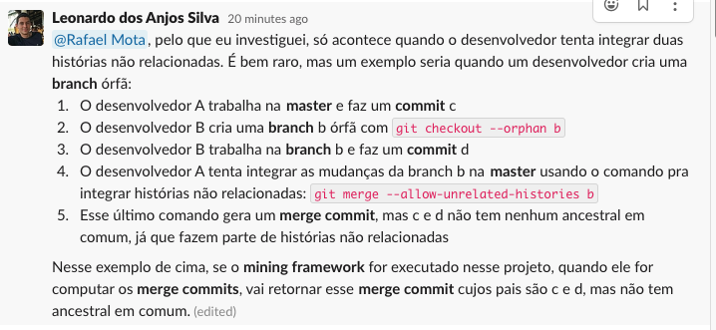

Slide 73
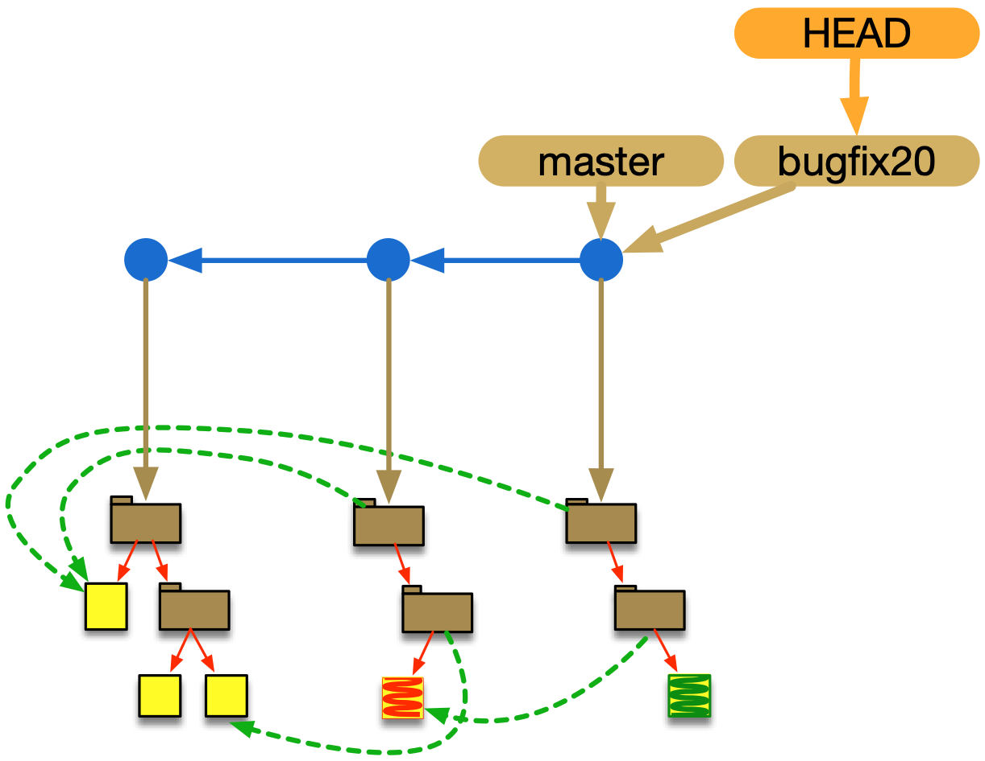

Slide 74
evolving a branch by creating new commits

Slide 76
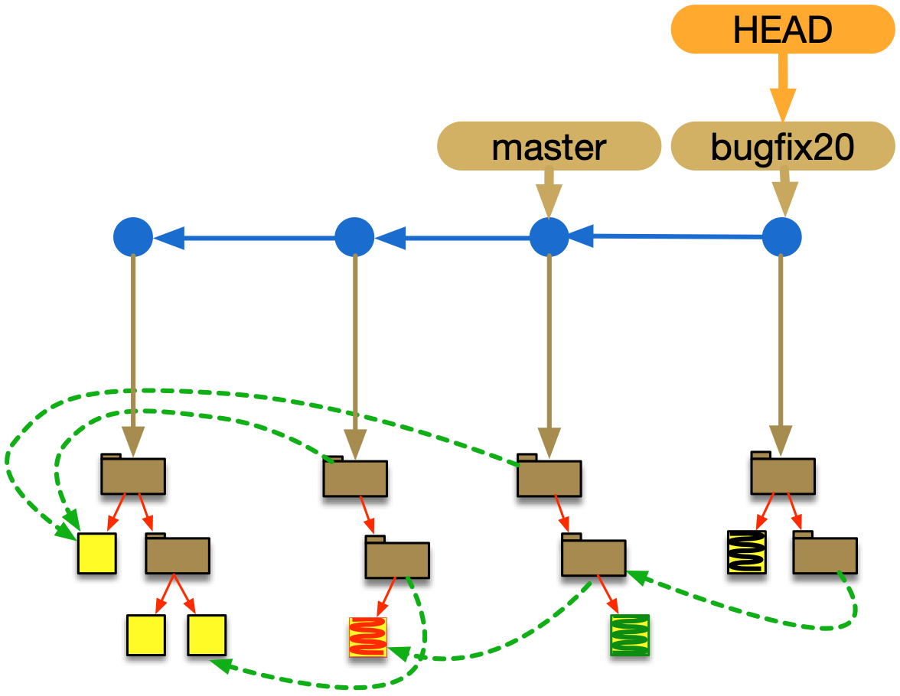

Slide 77
git checkout effect on working area

Slide 78
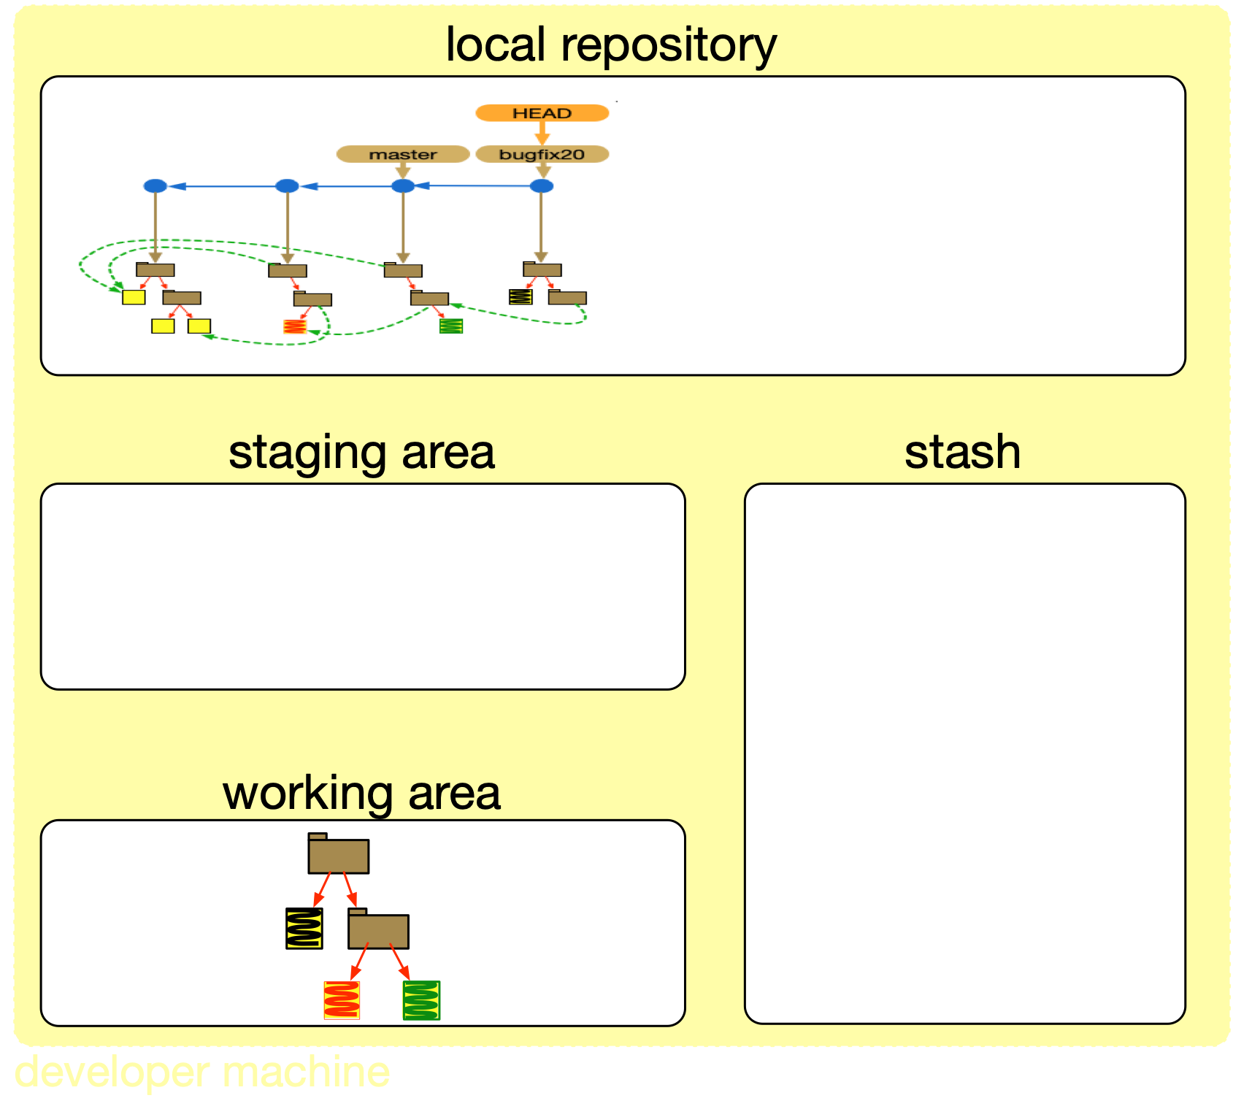

Slide 79
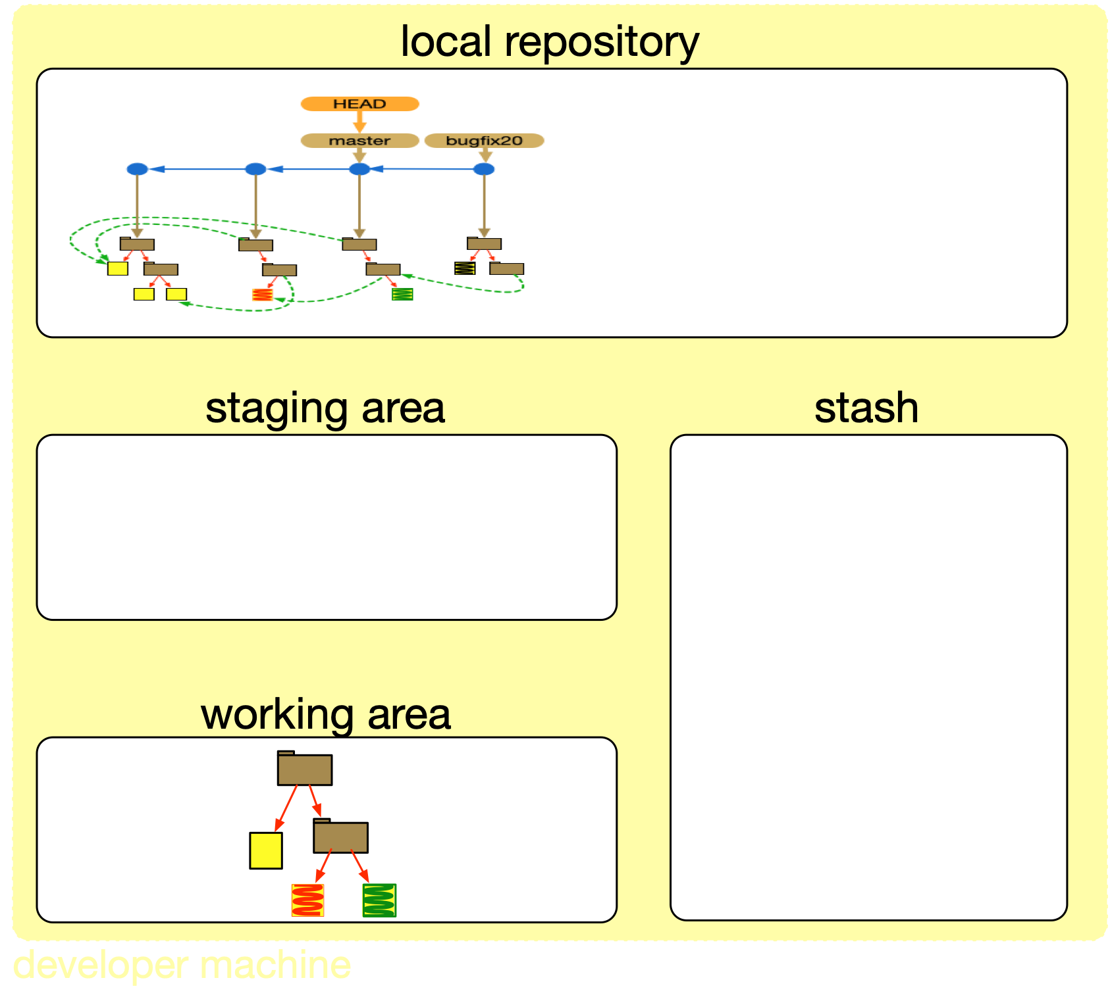

Slide 80
checkout para outro branch sem ter dado commit em mudança feita no working directory
“leva" mudanças para o novo branch, ou seja nao limpa a working area, so traz os arquivos do novo branch para a area, podendo dar conflito com os existentes

Slide 81
evolving another branch by creating new commits

Slide 83
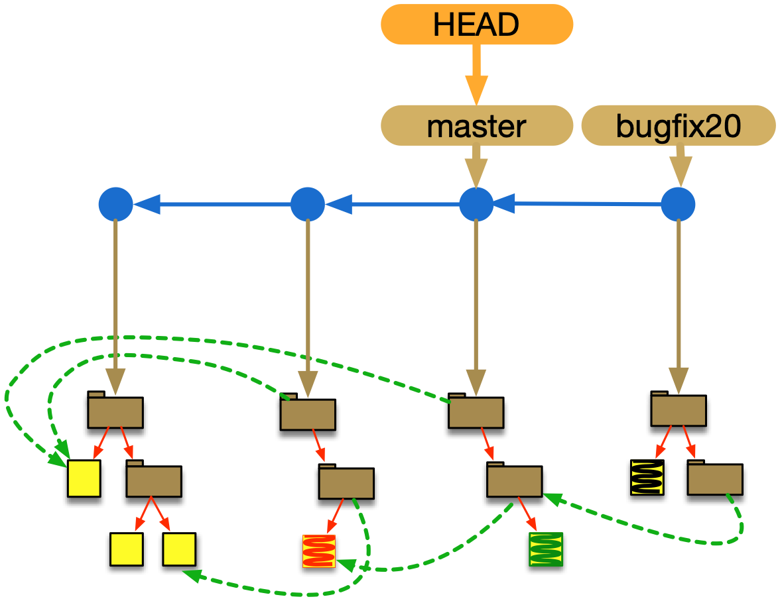

Slide 84
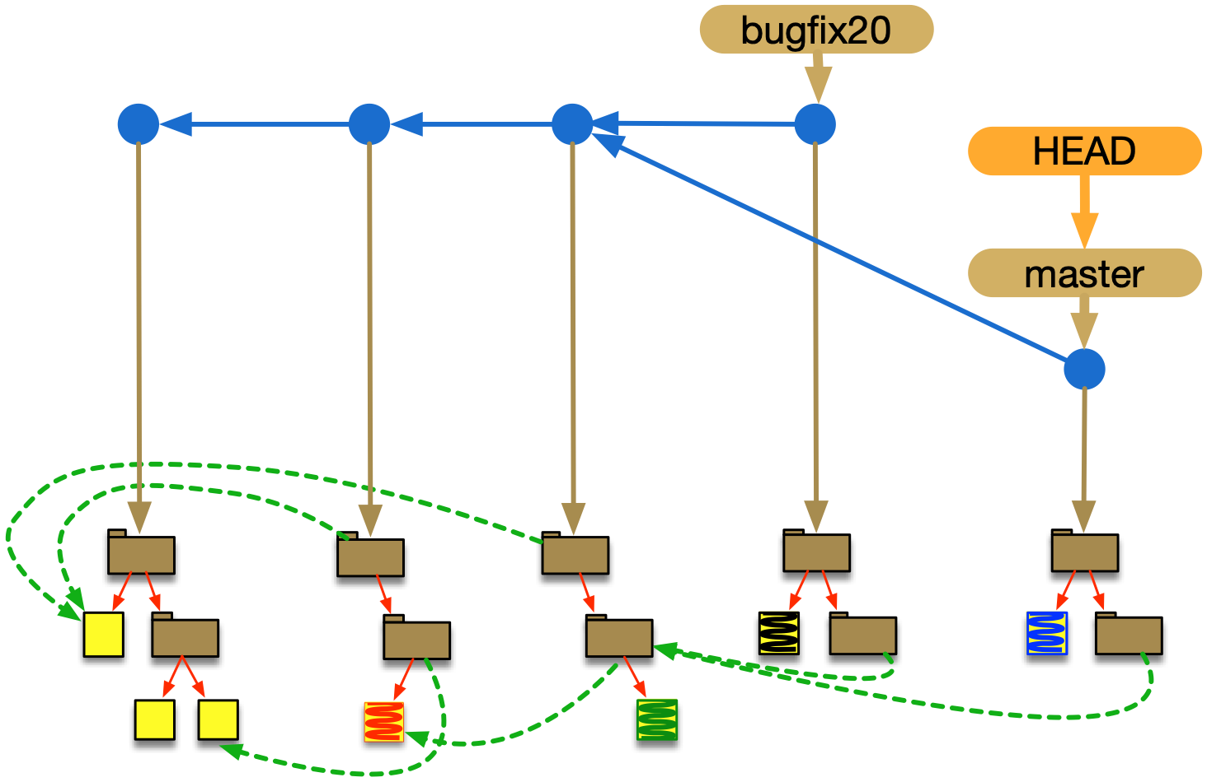

Slide 85
Integrating code contributions

Slide 86
git merge
merging locally

Slide 87


Slide 88
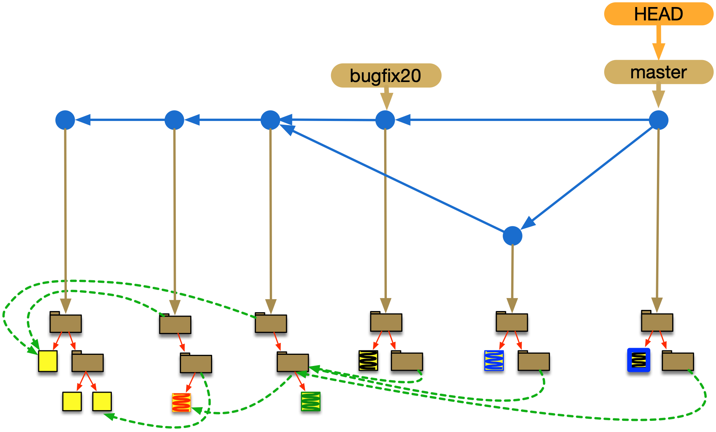

Slide 89
multiple branches and lines
multiple merges

Slide 90
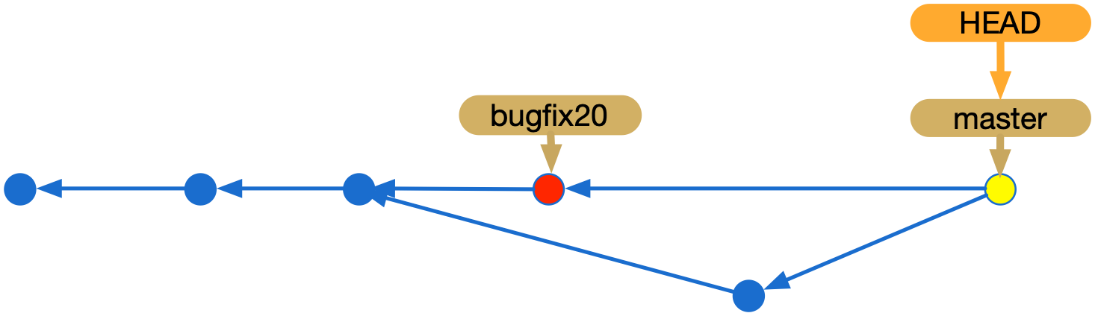

Slide 91
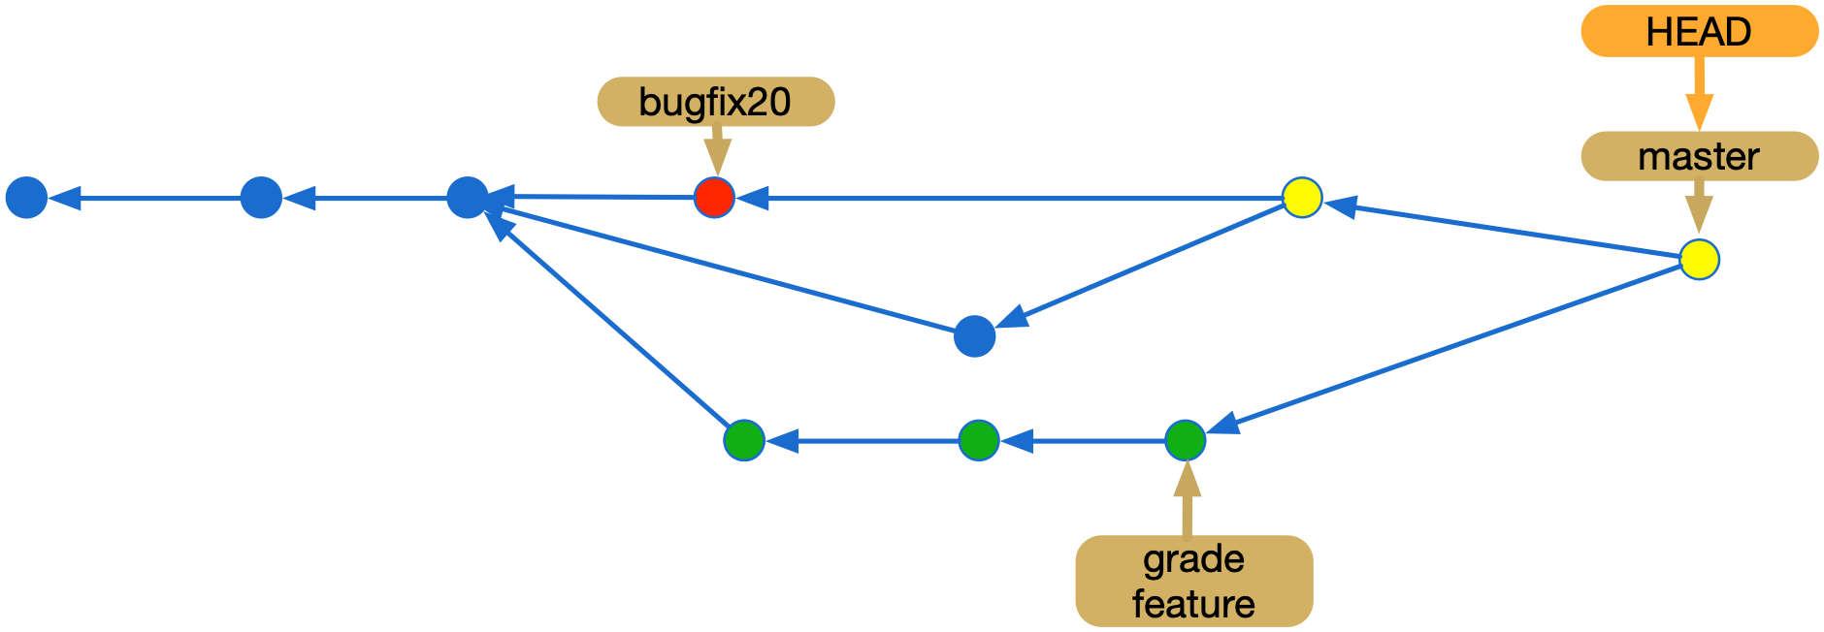

Slide 92
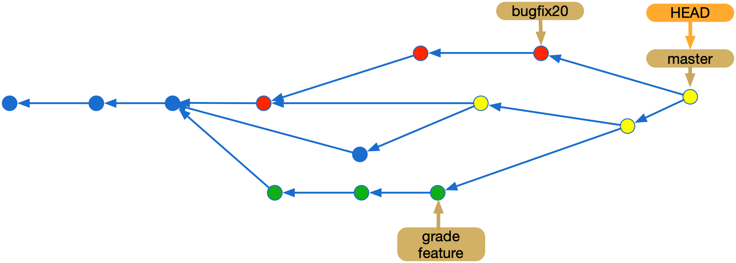

Slide 93
commit hashes
git checkout for branches and hashes
ed7058d9fd9ef55eed72abf29752bc50aa43ac5b
331cd13938e1487b8fbb2dd2fe7714d4934cf274
5fe7dfebaabc5c60f521568f96288f72dfb82c4c

Slide 95
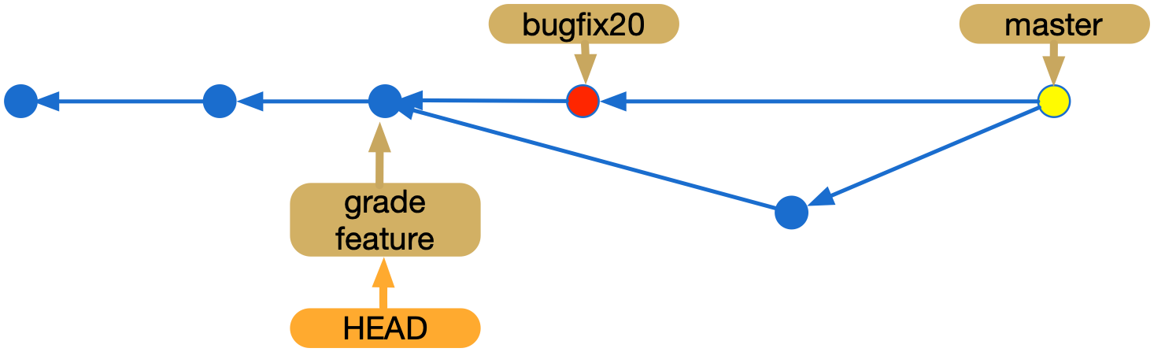

Slide 96
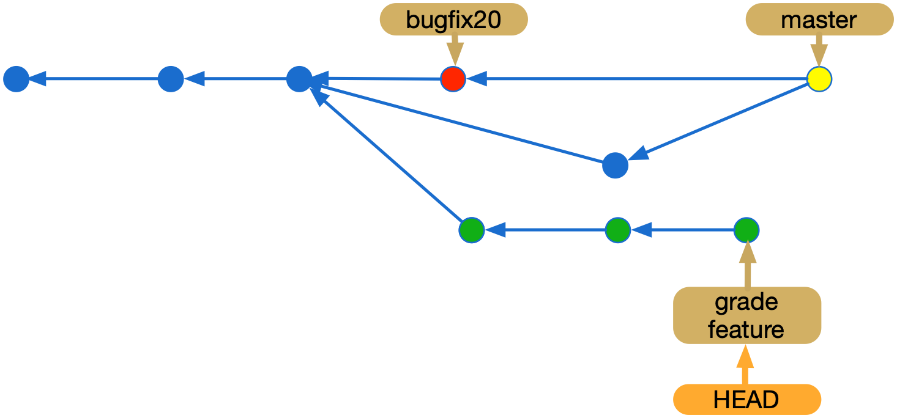
Notes:
recomendacao pra nomear branches

Slide 98
merge conflicts

Slide 99
no problem when different files are changed

Slide 100
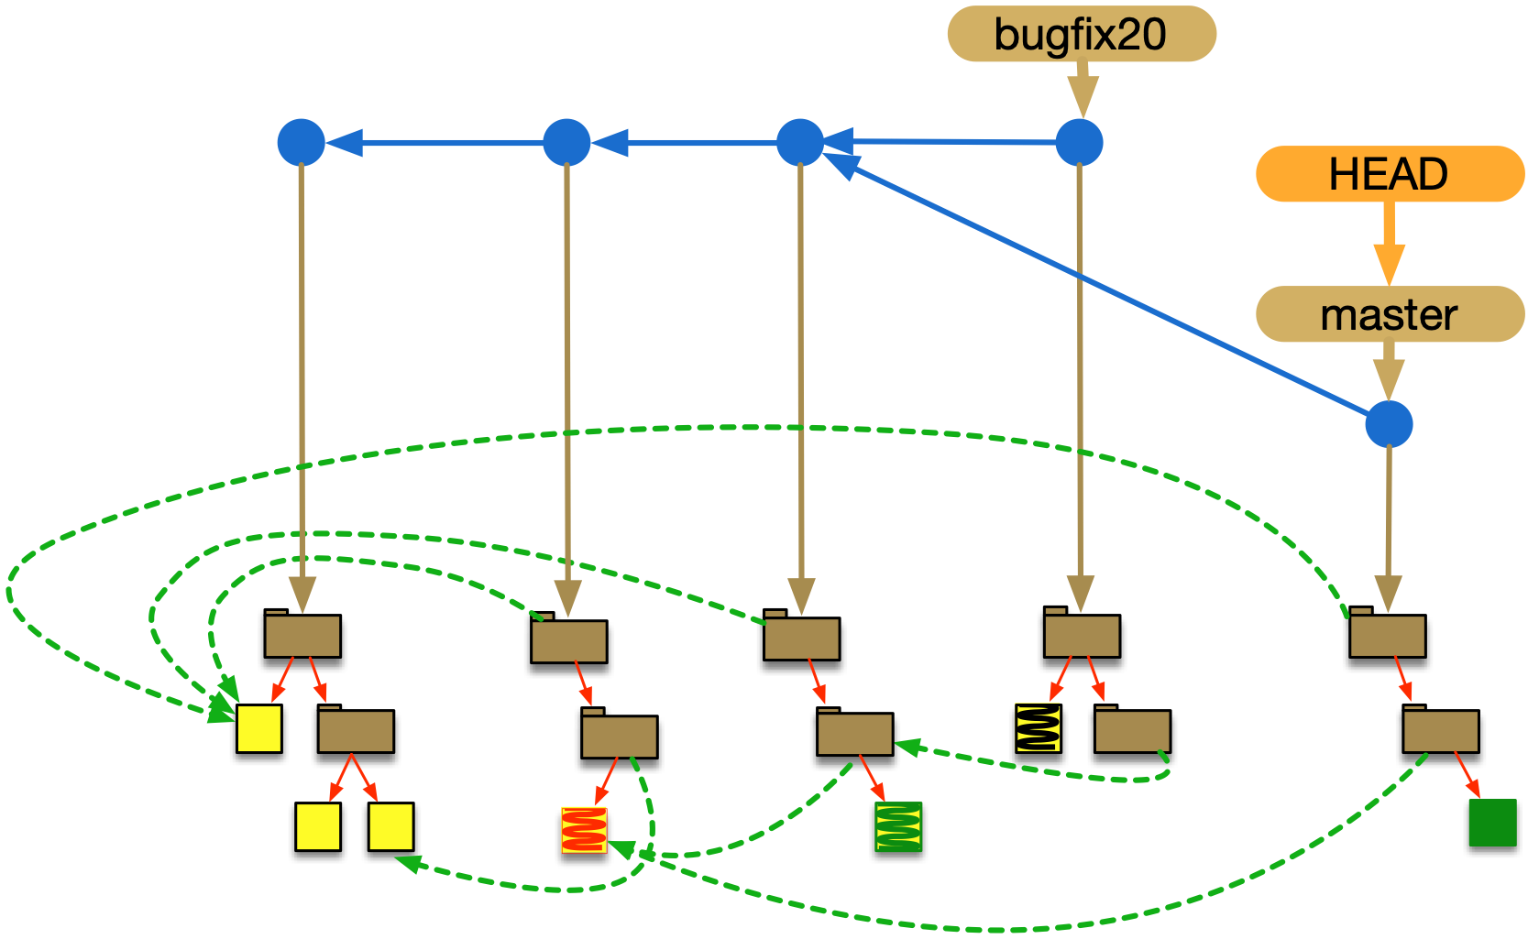
Notes:
falta descobrir o papel do base, só para o diff? para saber se deve haver conflito? não para saber quais arquivos devem ser usados… porque isso já se sabe pelos ponteiros

Slide 101
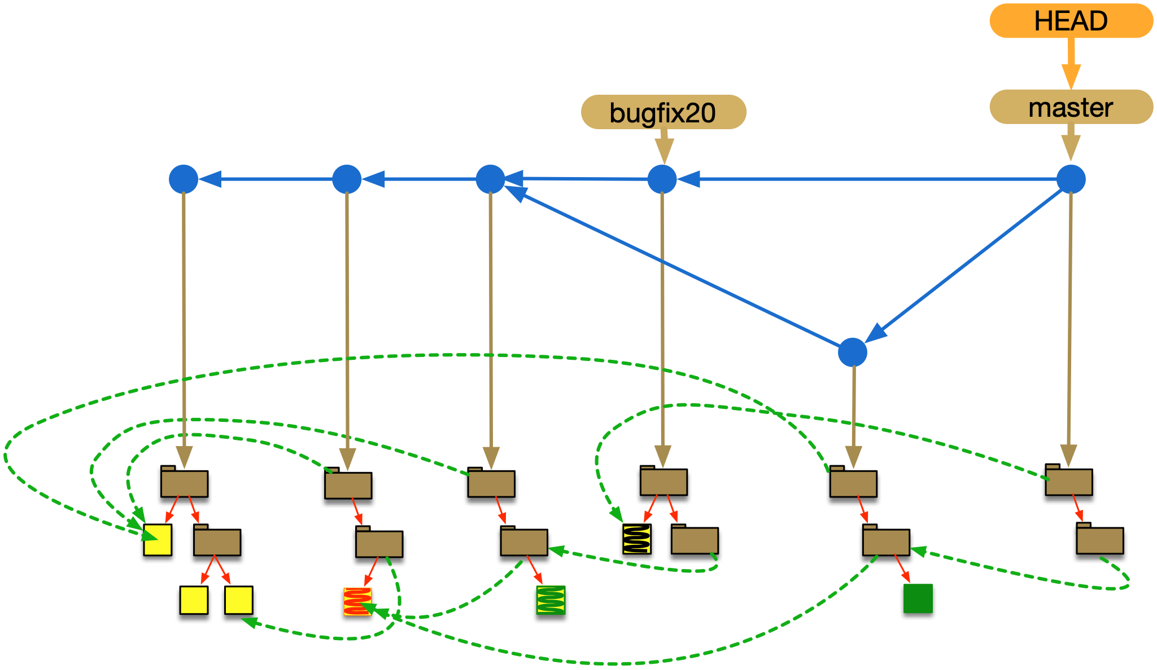

Slide 102
no problem if the same files are changed in different areas

Slide 105
but conflict if the same files are changed in the same areas

Slide 106
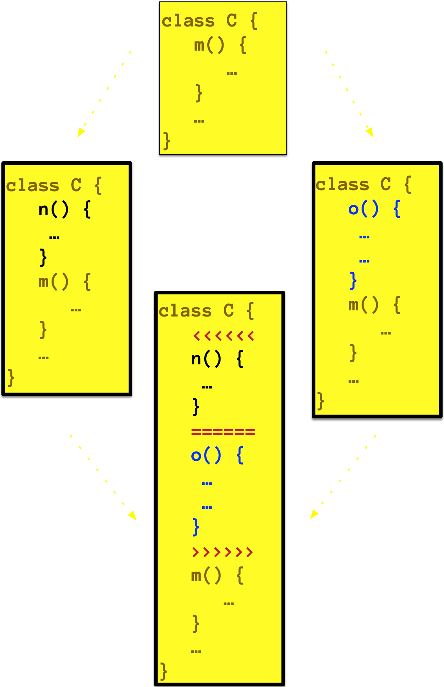
no merge commit is created
conflict markers

Slide 107
m() {
x=1;
y=2;
z=3;
}
m() {
x=0;
y=2;
z=3;
}
m() {
x=1;
y=2;
z=4;
}
m() {
x=0;
y=2;
z=4;
}

Slide 108
separators define areas

Slide 109
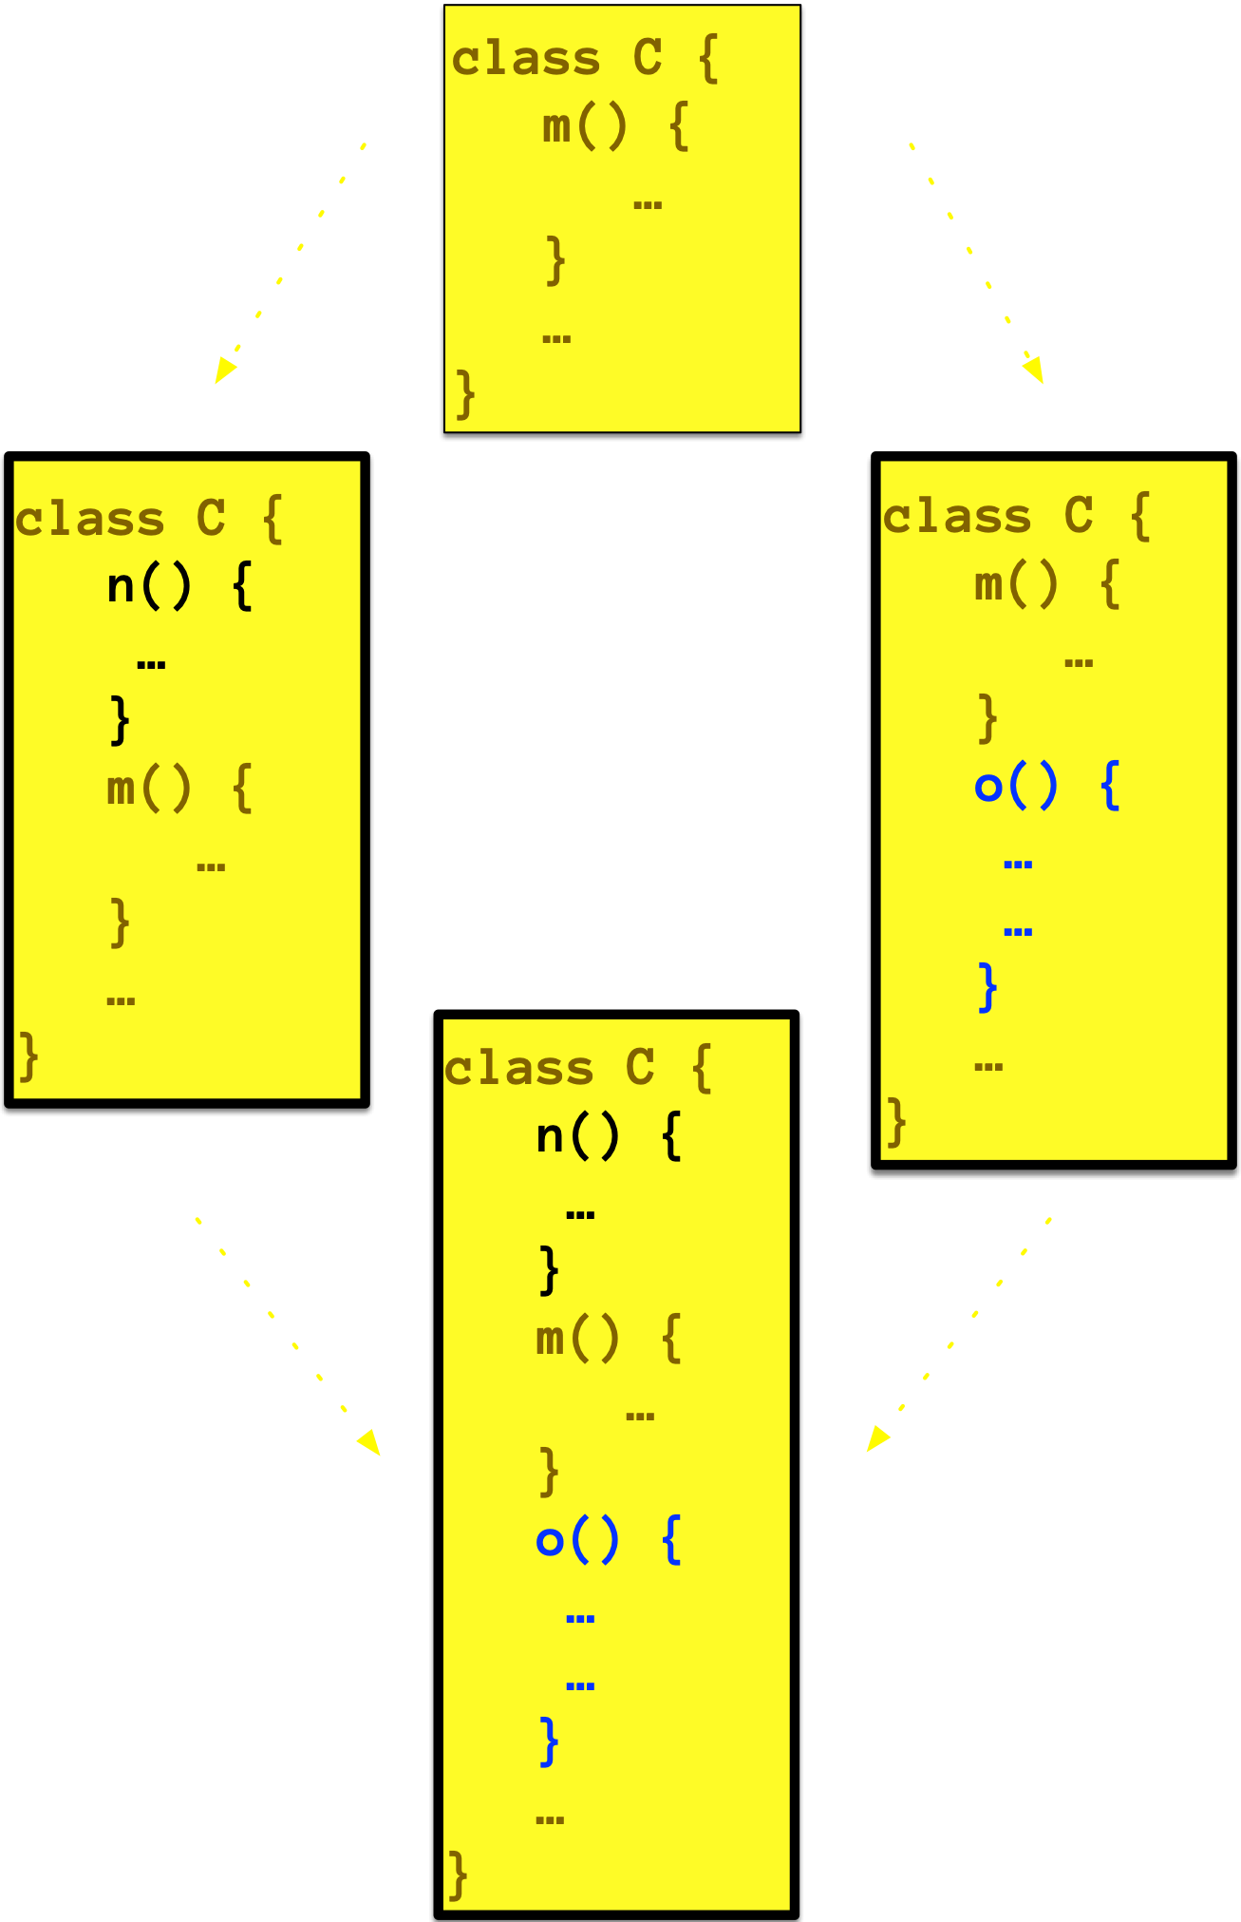
separator

Slide 110
git merge does not detect semantic conflicts

Slide 111
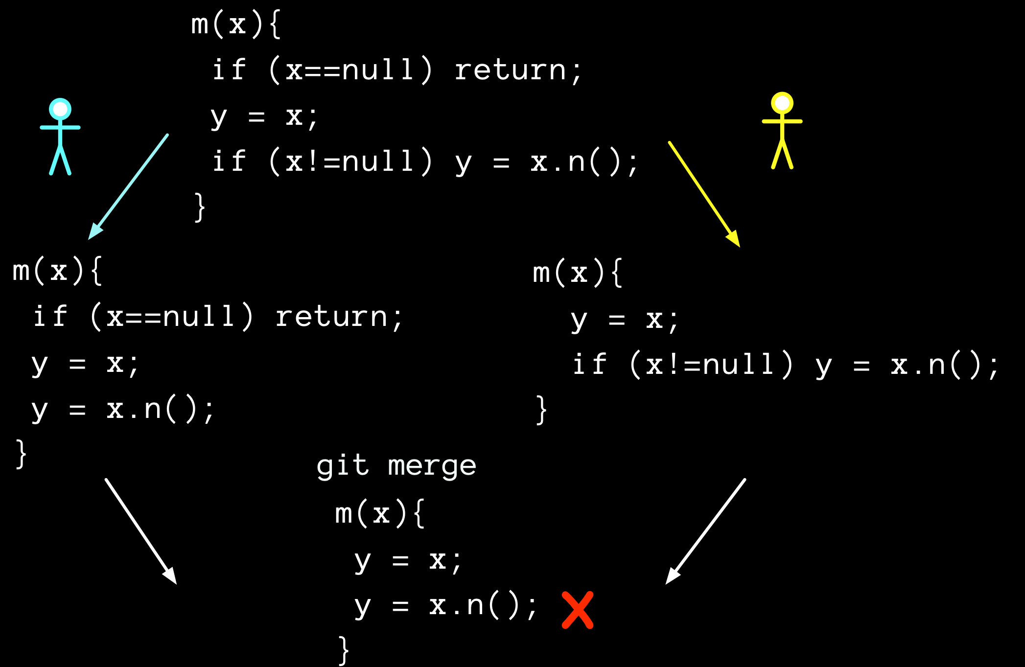
Notes:
left’s change is a refactoring, so there exists no initial state and variable x such that Base and Left each compute different final values for x.

Slide 112
git merge, opção para nao considerar whitespace, nao considera linhas em branco.
possibilidade de mais de uma base; criss-cross merge; octopus; git merge base; ver discussoes com guilherme
With the strategies that use 3-way merge (including the default, recursive), if a change is made on both branches, but later reverted on one of the branches, that change will be present in the merged result; some people find this behavior confusing. It occurs because only the heads and the merge base are considered when performing a merge, not the individual commits. The merge algorithm therefore considers the reverted change as no change at all, and substitutes the changed version instead.

Slide 113
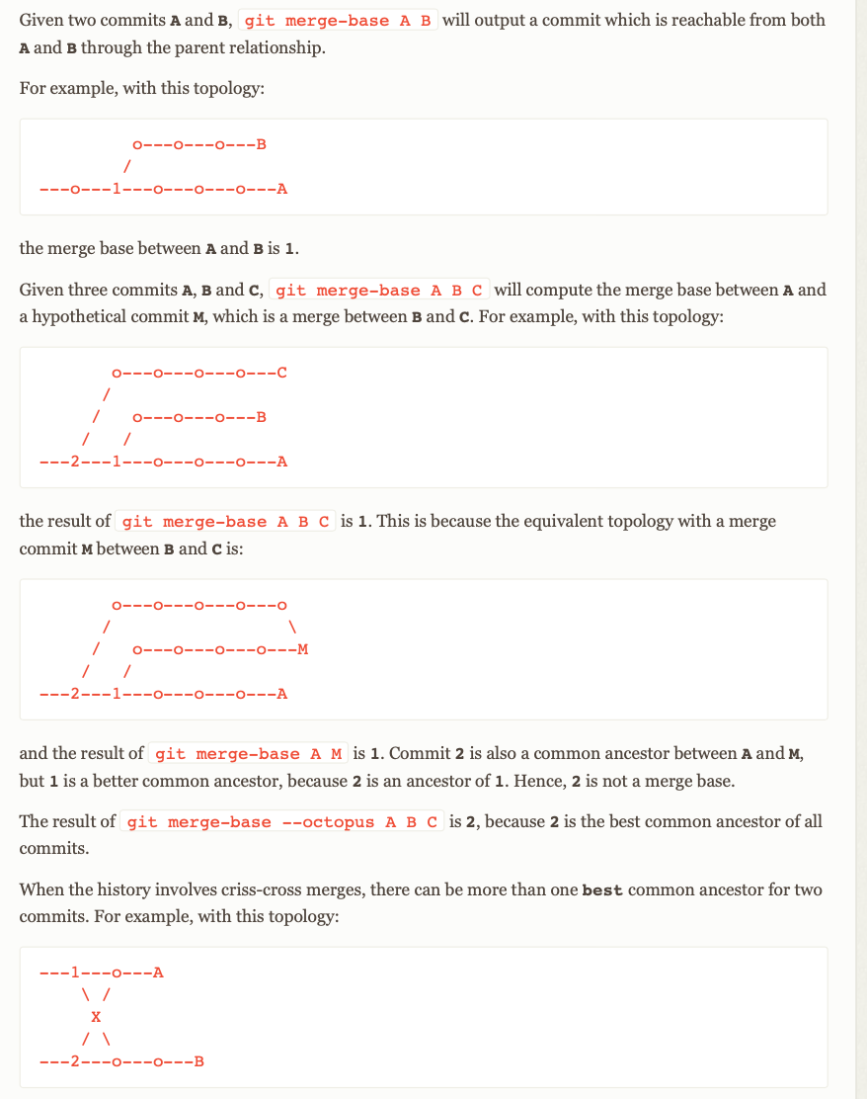
Notes:
https://git-scm.com/docs/git-merge-base

Slide 114
Take notes, now!

Slide 115
Hands on exercises
Notes:
Indo de aluno por aluno, verificando o progresso, e registrando como comentário no assignment do classroom.

Slide 116
Configuration management 2, advanced concepts and operations

Slide 117
Configuration management 3, continuous integration and deployment

Slide 118
Branches

Slide 119
Branches are used for supporting…
independent development
feature or component development
bug fixing
bug fixing in previous releases
customer specific variants (not a good idea, better options available)

Slide 120
Branches isolate changes until they are...
mature (do not break other functionality)
chosen for a release (in master)
ready to be updated with other changes (from master, without breaking development flow)
reconciled with alternative functionality
Notes:
talvez melhor na aula passada mesmo!

Slide 121
But we should use with care

Slide 122
Risks of branching
isolation provided by branches reduce pressure to integrate changes (increase time to market)
delayed integration
increase the risk of conflicts, which are harder to solve the latter they are detected
developers might avoid refactoring because of the risk of conflicts

Slide 123
promiscuous— branch to branch— integration, or from master to branch, could reduce the risks

Slide 124
Code integration is not restricted to branches in a single repository

Slide 125
git pull
(fetch + merge)
merging with remote
Notes:
fetch só traz commits para o repo local, nao atualiza stage e working. pull da o fetch, e tenta fazer o merge, criando um novo commit e atualizando working area

Slide 126
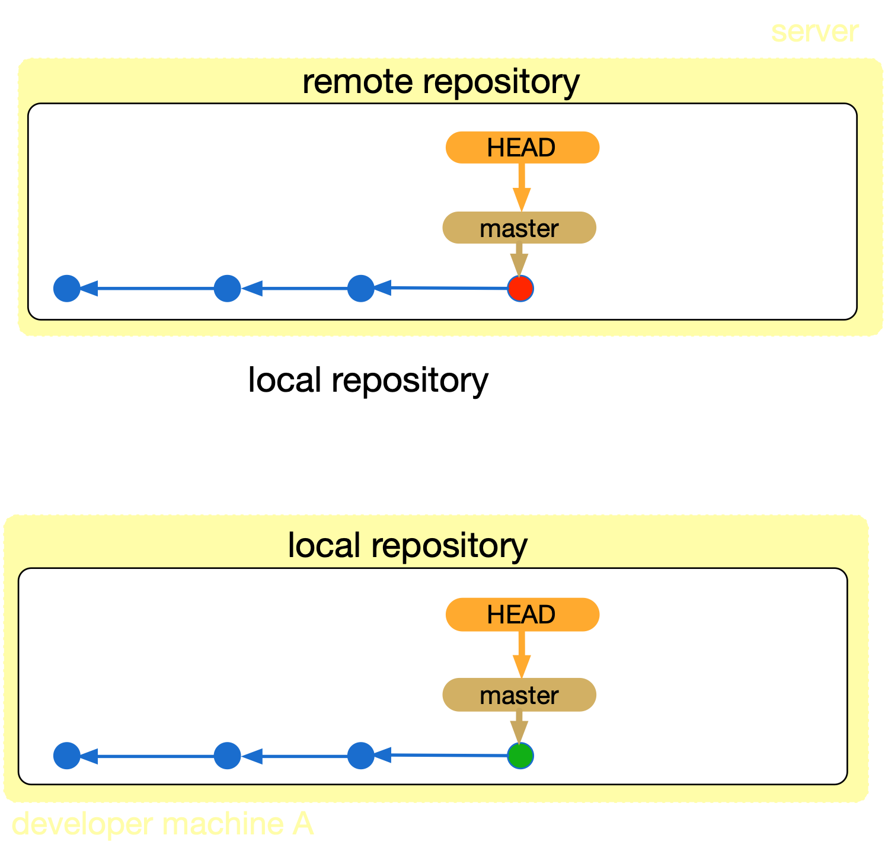
pull

Slide 127
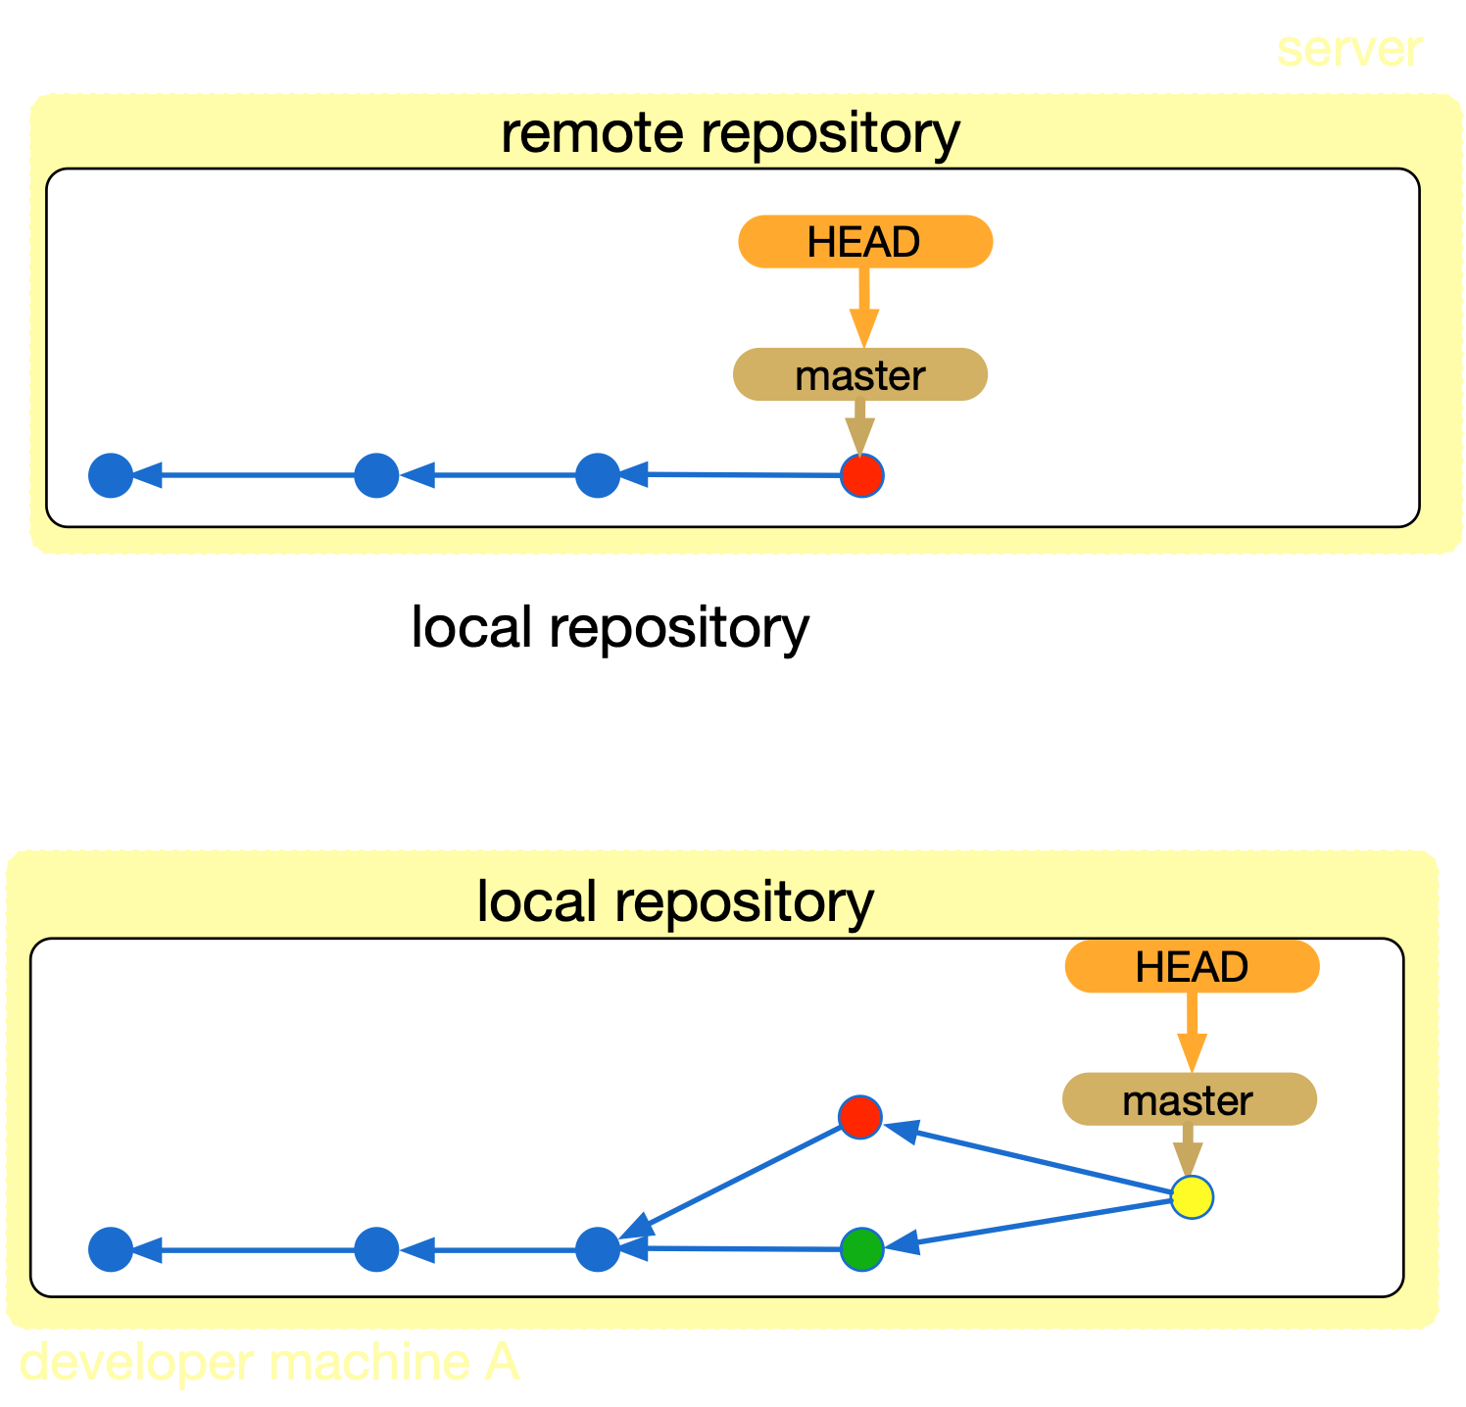
push

Slide 128
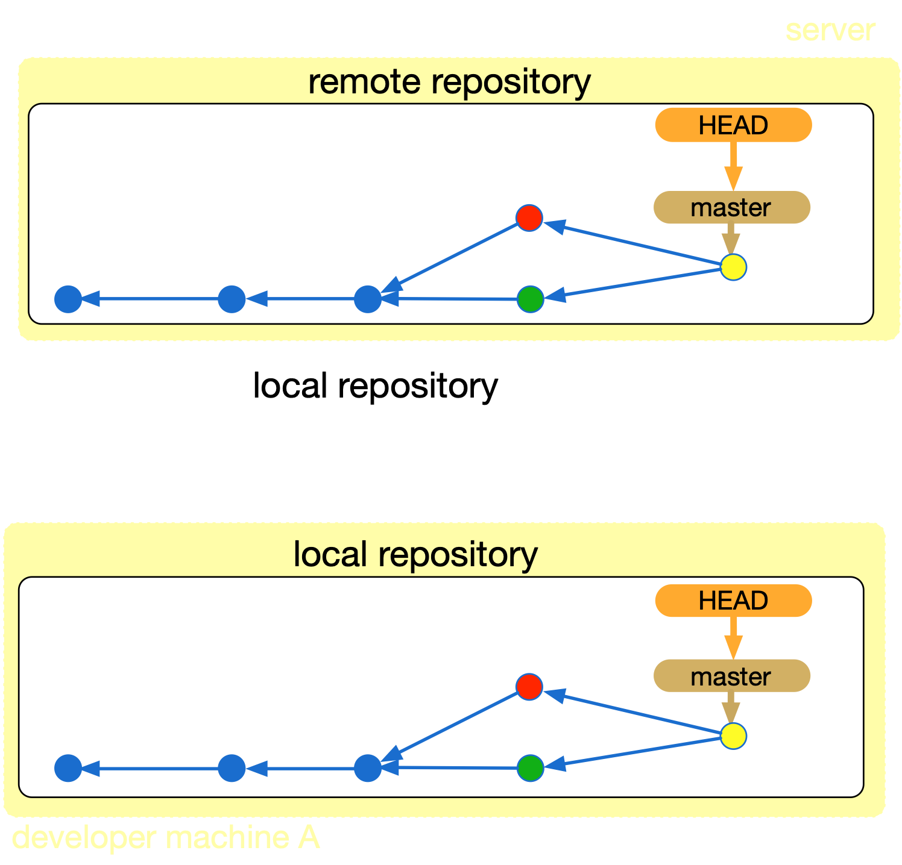

Slide 129
git stash
temporarily saving partial changes

Slide 130


Slide 131
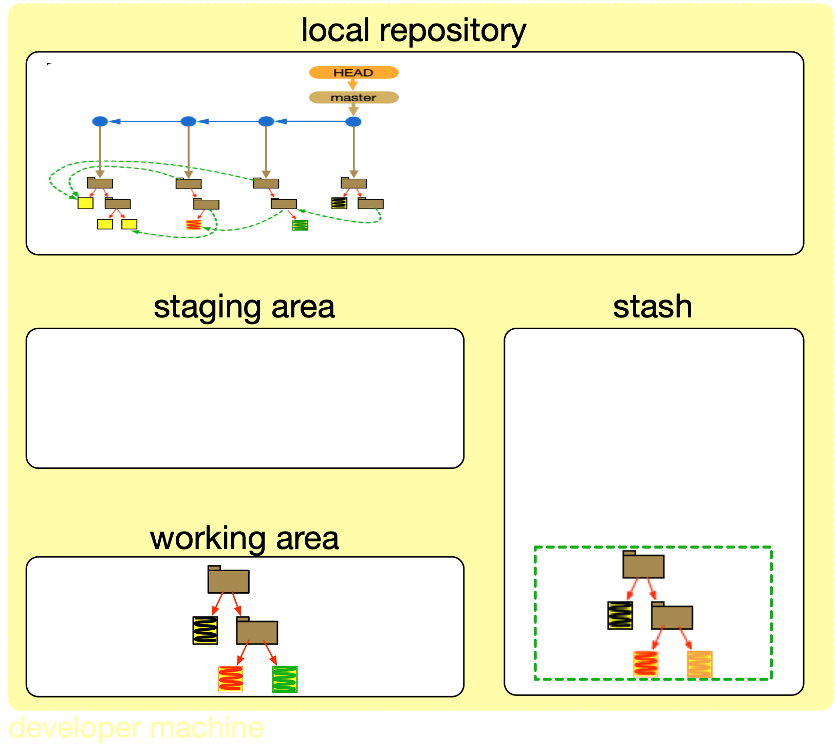

Slide 132
1. O commit mais recente do seu master privado, e do repositório principal, é C1
2. Você começa a trabalhar em uma nova feature (em master mesmo), alterando arquivos, mas sem ainda dar commit
3. Mr Timbu envia uma correção crítica para o repositório principal, commit C2, e avisa a toda equipe para atualizar logo seus repositórios locais
4. Como você ainda não concluiu uma mudança lógica que merecesse um novo commit, você dá git pull
5. As mudanças de C2 conflitam com as suas, que ainda não foram comitadas
6. Você da stash nas suas mudanças, e vai haver um fast-forward no seu repositório, que agora ficará com C1 -> C2
7. Você da unstash, resolve os conflitos, termina a mudança lógica que merece um commit, e dá git commit
8. Seu repositório fica C1->C2->C3, sem commit de merge, mesmo tendo havido uma integração entre o seu código e o de Mr Timbu
Se em 4 você tivesse dado um commit antes do pull, o commit de merge teria sido criado e a integração seria capturada pela nossa análise!

Slide 133
stash area is a stack

Slide 134
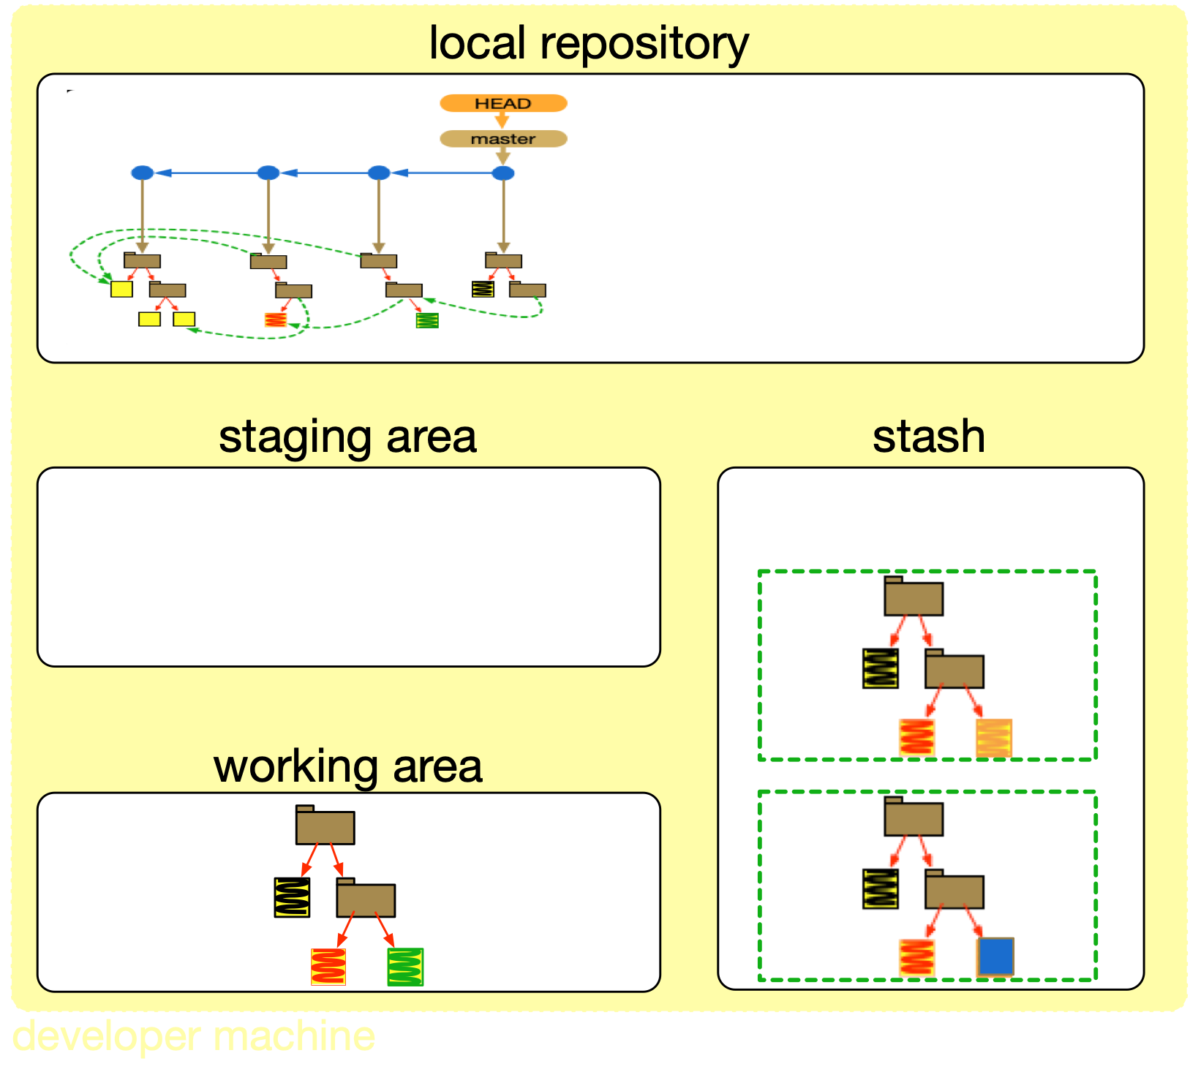

Slide 135
git stash drop (pop)
git stash apply

Slide 136
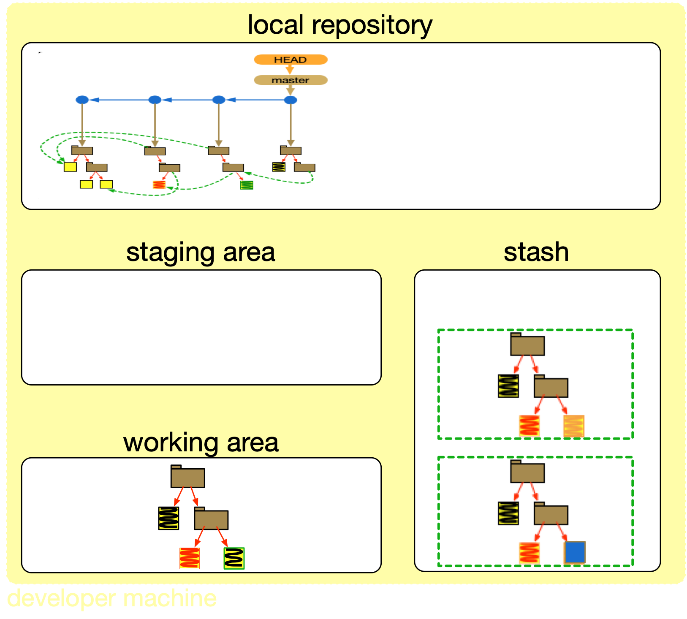

Slide 137
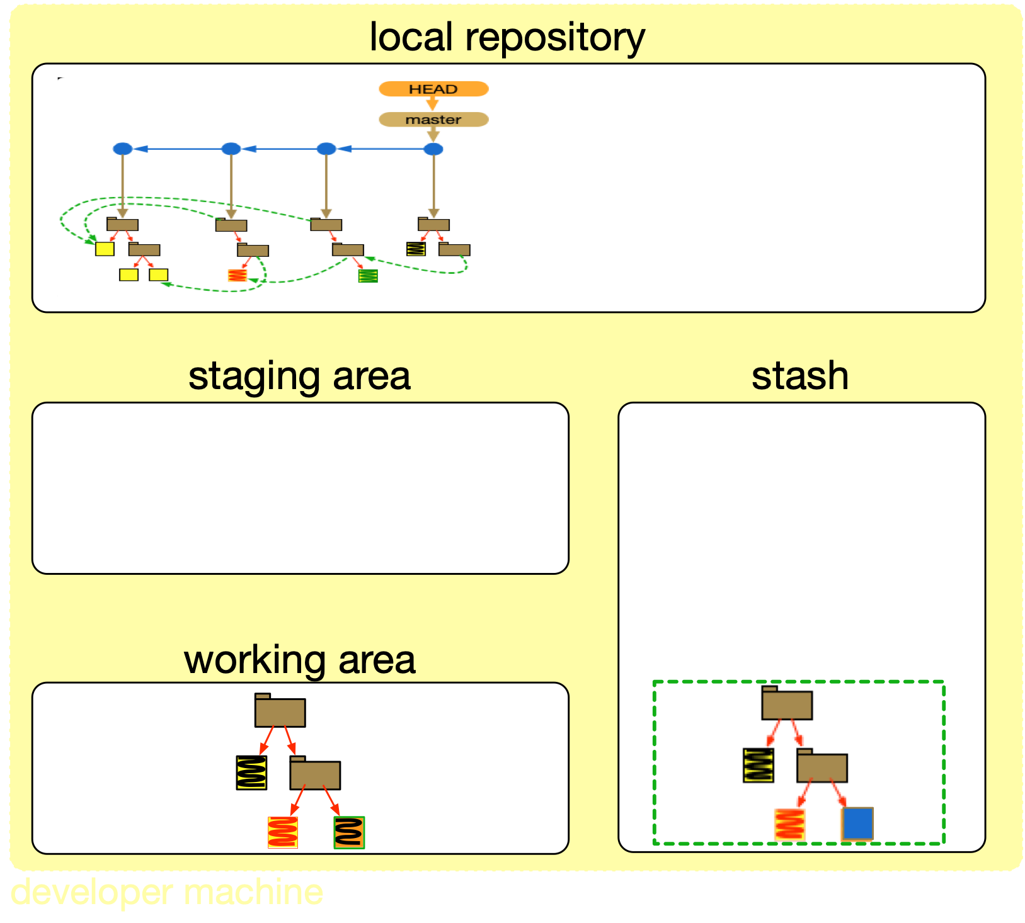

Slide 138
stash code is integrated to the working area
conflicts might arise

Slide 139
Other code integration commands

Slide 140
git rebase
Notes:
https://git-scm.com/docs/git-rebase

Slide 141

merge might complicate history

Slide 142
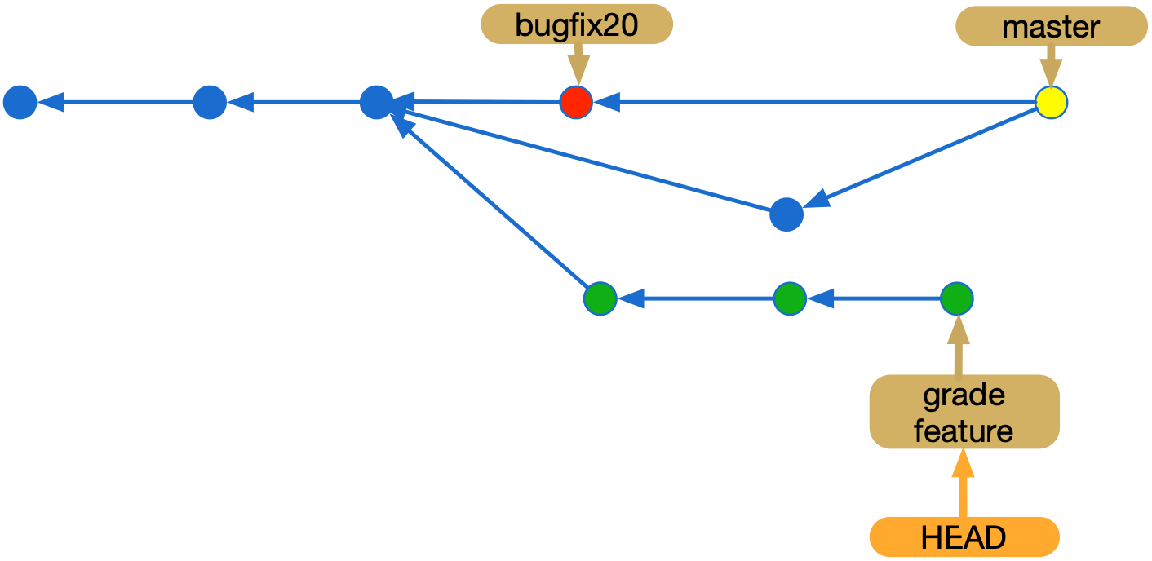
Notes:
(in grade feature) git rebase master
git rebase master grade-feature

Slide 143
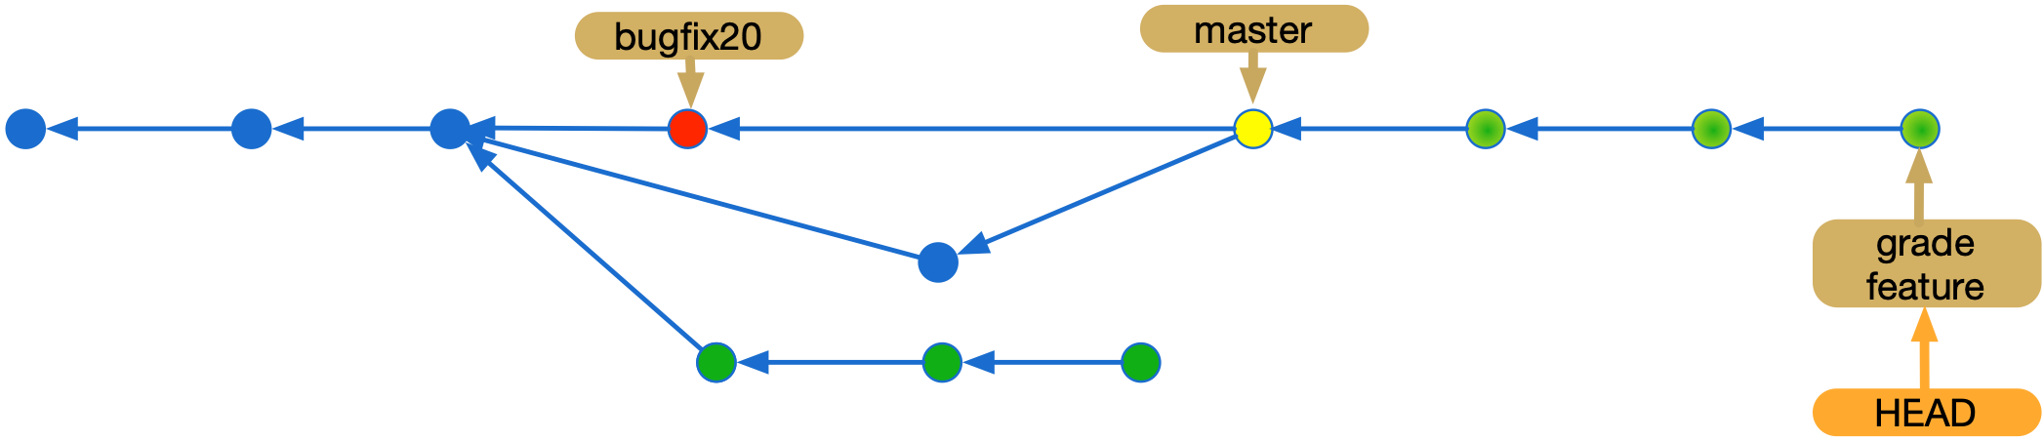
Notes:
para mover o ponteiro do branch: git branch -f <branchname> <start-point>

Slide 144
Notes:
(in grade feature) git rebase master
git rebase master grade-feature

Slide 145
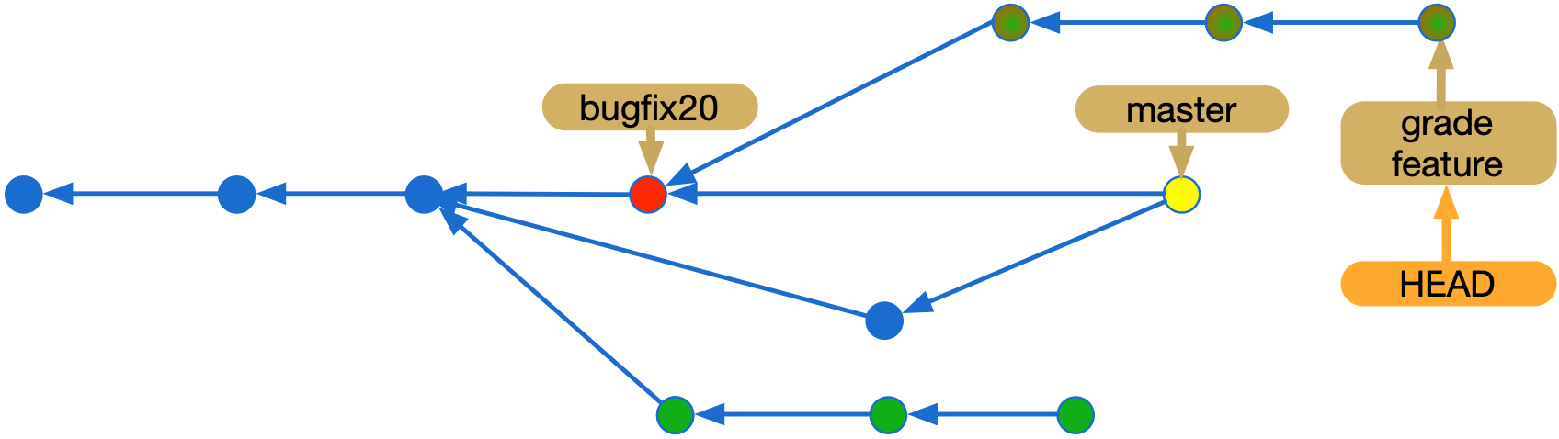

Slide 146
interactive rebase
squash

Slide 147
git cherry-pick
Notes:
https://git-scm.com/docs/git-cherry-pick

Slide 148
Notes:
(in grade feature) git rebase master
git rebase master grade-feature

Slide 149
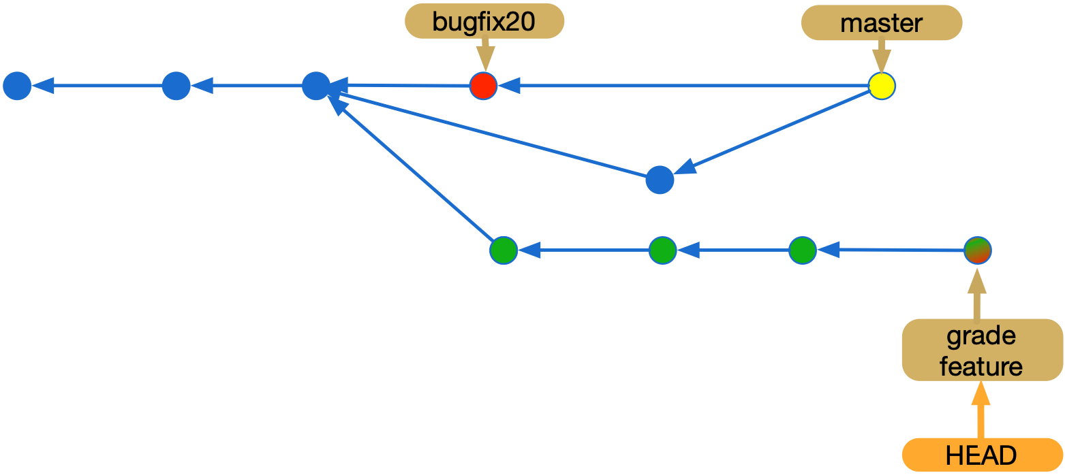

Slide 150
Advanced

Slide 151
git config

Slide 152
git tag

Slide 153
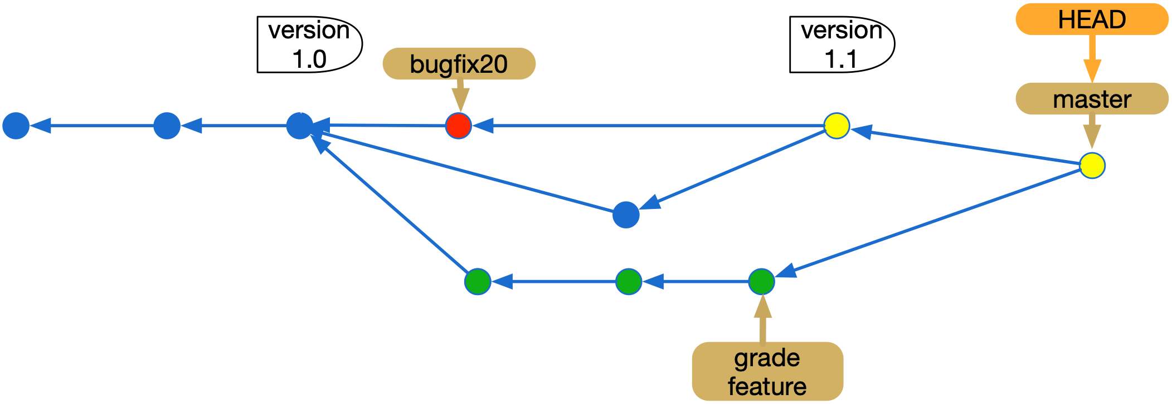

Slide 154
git reset
reset --soft X: makes HEAD and the current branch point to X (X could be HEAD~ or hash)
reset --mixed X (default): same as before plus updates stage (index) with X contents
reset --hard X: same as before plus updates working directory with X contents
Notes:
reset with a path affects only the specified file, and skips the first step (changing the current branch)
checkout X: makes HEAD point to X (mixes local dir content with the one in X, changing the local directory and committing leads to detached head mode, branch has to be specified)

Slide 155
Commit
1 hash: 40 hex characters (SHA)
Parent commits, message, author/commiter, email, time
Not diffs
Root (Merkle) tree, contains names of files and folders inside (and file modes)
Blobs (binary large objects; file contents, not names)
git cat-file -p commit_hash (to see commit contents, all with identifiers based on SHA)
Notes:
https://en.wikipedia.org/wiki/Merkle_tree
In cryptography and computer science, a hash tree or Merkle tree is a tree in which every leaf node is labelled with the cryptographic hash of a data block, and every non-leaf node is labelled with the cryptographic hash of the labels of its child nodes. Hash trees allow efficient and secure verification of the contents of large data structures. Hash trees are a generalization of hash lists and hash chains.
Demonstrating that a leaf node is a part of a given binary hash tree requires computing a number of hashes proportional to the logarithm of the number of leaf nodes of the tree;[1] this contrasts with hash lists, where the number is proportional to the number of leaf nodes itself.
The concept of hash trees is named after Ralph Merkle who patented it in 1979.[2][3]

Slide 156
Summary of git concepts

Slide 157
Workflows
Creating repositories (locals, remotes, bare, fork, clone)
Recording changes (working area, stage, tracked, ignored, assume unchanged, commit)
Branching (pointer, master, HEAD, stash)
Notes:
If a tracked ﬁle is updated, a subsequent commitat least one without special arguments—will save the older version of the ﬁle (representing its state the last time add was called), and not the latest one.
Files that are currently not under version control are “untracked.” Alternatively, a set of ﬁles (given implicitly by a path-speciﬁer in a special ﬁle) may be designated as “ignored.” This feature enables the user to prevent ﬁles from being committed by naming them before they even exist, and is used, for example, to prevent committing non-source ﬁles. But tracked ﬁles cannot be ignored; to ignore a tracked ﬁle one has to mark it as “assume unchanged.” 3 This “assume unchanged” ﬁle will not be recognized by add; to make it tracked again this marking has to be removed.
Files that are currently notSome operations can put the user in a “detached HEAD” state: HEAD, a reference that tracks where the user is working on, can “detach” from a branch and point directly to a commit, instead of pointing to one through a branch. New commits created in this state will not belong to any branch.
But switching branches can be a complex matter, because, although branches are maintained separately in the repository, there is only one working directory and one staging area. As a result, when a user switches branches, ﬁles may be unexpectedly overwritten. Git fails with an error if there are any conﬂicting changes, effectively preventing the user from switching in this case. To mitigate this problem, Git provides a way to save versions of ﬁles to another storage area, called the “stash,” using a special command issued prior to the branch switch.

Slide 158
Workflows
Tagging (pointer not updated by commit)
Integrating changes (merge, rebase, cherry-pick, conflicts, squash)
Synchronizing repositories (push, pull, PR, remote branch, upstream branch)
Notes:
Crucial to the understanding of how syncing with other repositories work is the notion of a “remote branch,” also called a “remote-tracking branch.” This is a branch (pointer to a commit) that (asynchronously) reﬂects the state of a branch in another repository. It is updated whenever there is some network communication (e.g., a push or fetch).

Slide 159
Storage areas
Non-bare Repository
Bare Repository
Commit
Staging Area
Stash

Slide 160
References
Head
Tag
Branch
Upstream Branch (sync default)
Remote Branch

Slide 161
File classifications
Tracked
Untracked
Ignored
Assume Unchanged
In Conﬂict

Slide 162
Continuous
building and testing
integration
deployment
at least daily

Slide 163
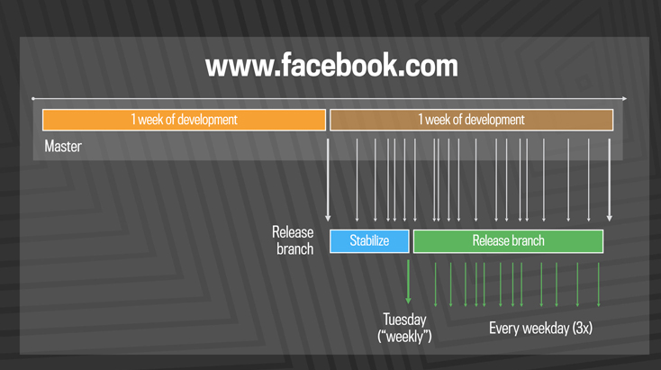
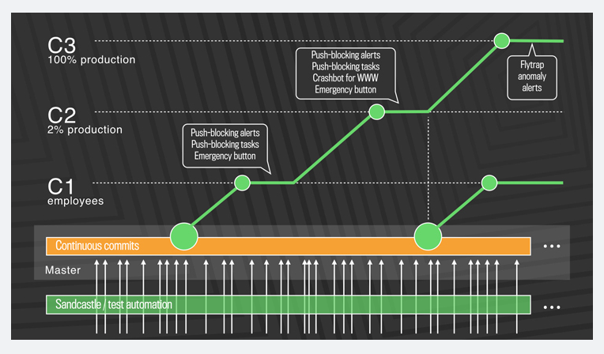

https://code.fb.com/developer-tools/rapid-release-at-massive-scale/?utm_content=bufferb0e59&utm_medium=social&utm_source=twitter.com&utm_campaign=buffer

Slide 164
Advantages and disadvantages
No need for hotfixes
Better support for a global engineering team
Scales (number of developers, commits, etc.)
Conflicts are detected early
High quality, confident developers
Might break development flow (due to code that might not even be released)
Need for Gatekeeper system
feature flags might pollute the code
part of the functionality might become dead code

Slide 165
Before integrating…
Review scenarios and features, or write scenarios in pairs
Make sure they follow style and quality criteria
Organize review procedures and meetings

Slide 166
Checklist

Slide 167
Checklist
Clear commit messages, exactly corresponding to what has changed
no language errors
Commit early and often
avoid tangled commits
aim for conceptual, modular changes
Often integrate your code (small integrations, by merging to or from master)
Notes:
exemplos concretos de cada, sendo fica difícil entender. com figuras, para o ultimo, por exemplo!

Slide 168
Checklist
Antes de enviar um pull request, deve-se, obrigatoriamente, fazer um merge ou rebase para que suas modificações sejam aplicadas à versão mais atual do repositório central do seu projeto, não à última versão que você tinha na sua máquina e com informações desnecessárias.
A mensagem do pull request deve descrever com precisão e clareza o seu conteúdo.
Cada pull request deve incluir somente os arquivos que foram alterados para a atividade.
Notes:
TRADUZIR, COM MENOS TEXTO

Slide 169
Checklist
Pull requests não devem conter arquivos gerados ou de configuração particular de cada máquina ou IDE, como .classpath, .project, .class. O mesmo vale para arquivos de log e similares. Não deve-se dar commits nesses arquivos. Use o .gitignore para evitar esse problema.
Evite pular linhas, adicionar espaços, etc. em partes do código que você não precisa modificar; cada mudança desss precisa ser analisada por quem vai integrar a sua contribuição ao repositório principal, e podem gerar conflitos.
Tenha certeza de que todos os testes estejam passando na versão incluída no pull request.

Slide 170
Change requests and change managements

Slide 171
Issues or change requests
Bug report
Need for new feature or scenario
Need for changing a particular feature
Need for code improvement
Need for performance improvement
Chore description (provide no direct value to the customer)

Slide 172
Take notes, now!

Slide 173
Hands on exercises
Notes:
Indo de aluno por aluno, verificando o progresso, e registrando como comentário no assignment do classroom.

Slide 174
Configuration management 3

Slide 175
CM research at CIn
Advanced merging tools: Paulo
Collaboration conflicts characteristics: Paulo

Slide 176
To do after class
Answer questionnaire (check classroom assignment), study correct answers
Finish exercise (check classroom assignment), study correct answers
Read, again, part of chapter 10 in the textbook
Evaluate classes
Study questions from previous exams
Notes:
intercalar teoria com roteiro

Slide 177
To do after class
Use Pro Git, and Git Cheat Sheet as references
Read either Git concepts simplified or A Visual Git Reference
Opcionalmente, ler artigo que descreve um workflow colaborativo, e outro artigo que adiciona mais alguns detalhes
Opcionalmente, instale e use uma ferramenta que ajuda na resolução de conflitos

Slide 178
Questions from previous exams
Explique brevemente (a) o que é um branch em um sistema de controle de versão, e (b) porque você criaria um em seu projeto. Explique também (c) o propósito e o funcionamento da operação de merge.
Podemos tanto fazer merge de mudanças do branch principal em um branch de feature (atualizando o branch de feature) quanto fazer merge de mudanças de um branch de feature no branch principal (atualizando o branch principal)? Explique brevemente sua resposta.

Slide 179
Software and systems engineering
Paulo Borba
Informatics Center
Federal University of Pernambuco
phmb@cin.ufpe.br ◈ twitter.com/pauloborba

Slide 180


About me
Derrick Stolee
Software Engineer
Git Ecosystem
Git
Git for Windows
VFS for Git
https://github.com/git/git/graphs/contributors

Slide 181


About me
Derrick Stolee
Live in Raleigh
Work in RDU
Dr. Kathryn Stolee
SE Faculty at NCSU
Looking for RAs!

Slide 182




Available roles and opportunities
Explore Microsoft
SE & Program Manager (PM) Internship
Full-Time
SE & PM
Links to these applications are also found at https://microsoft.com/university

Slide 183

How to Learn Git?
Play with it!
Read about it.
Use it with other people!
Free e-book:
https://git-scm.com/book/en/v2
10.2 Git Internals - Git Objects
2.3 Git Basics - Viewing the Commit History
2.2 Git Basics - Recording Changes to the Repository

Slide 184
Where to Get Git?
Linux: sudo apt-get install git
Windows: https://github.com/git-for-windows/git/releases
Mac: brew install git
https://git-scm.com/book/en/v2/Getting-Started-Installing-Git

Slide 185
How to follow along?
$ git clone https://github.com/git/git
$ cd git
$ git reset --hard v2.23.0

Slide 186
How to follow along?
$ git clone https://github.com/git/git
$ cd git
$ git reset --hard v2.23.0

Slide 187

Object Model

Slide 188

Object Model: Content-Addressable Data Store
Every object has a SHA-1 hash: 40 hex characters.
Given 40 hex characters, we can find the unique object with that hash.

Slide 189

Object Model: Content-Addressable Data Store

Slide 190

Object Model: Blob (Block)
A blob contains file contents.
Note: the file name is
not part of the object!

Slide 191

Object Model: Tree (Triangle)
A tree contains folder contents.
Contains names of files
and folders inside
Contains blobs (files)
and trees (folders)
Includes file mode
(Unix file permissions)

Slide 192

Object Model: Tree (Triangle)
A tree contains folder contents.

Slide 193



Object Model: Commit (Circle)
A commit contains many things:
A root tree.
A list of parent commits.
A commit message
An author name, email, time.
A committer name, email, time.
git config –global user.name “My Name”
git config --global user.email me@place.com

Slide 194

Object Model: Commit (Circle)
A commit contains many things:
A root tree.
A list of parent commits.
A commit message
An author name, email, time.
A committer name, email, time.

Slide 195

Object Model: Commit (Circle)
A commit contains many things:
A root tree.
A list of parent commits.
A commit message
An author name, email, time.
A committer name, email, time.

Slide 196
Object Model: Merkle Tree

Slide 197



IMPORTANT: Commits are NOT diffs!
File renames are
Detected dynamically!

Slide 198
Branches: Pointers to commits
HEAD
topic
shipped
master

Slide 199
git is DISTRIBUTED version control!
HEAD
topic
shipped
master

Slide 200


git switch : move between branches
(New in v2.23.0, replaces half of “git checkout”)
Change HEAD to point to new branch
Updates working directory to match commit’s tree

Slide 201


Working Directory, Staging, Committed
EXAMPLE!
https://stackoverflow.com/questions/3689838/whats-the-difference-between-head-working-tree-and-index-in-git

Slide 202

Working Directory, Staging, Committed
EXAMPLE!
https://git-scm.com/book/en/v2/Git-Basics-Recording-Changes-to-the-Repository

Slide 203

Advanced! Working Directory, Staging, Committed
Interactive add: git add -p
Presents the patch-diff in parts that you can add in pieces, or even modify in-place!
git commit -a
EXAMPLE!
git add -p
https://git-scm.com/docs/git-add#Documentation/git-add.txt-patch

Slide 204

git status is your friend

Slide 205

Working with Remotes
If you clone, you create special remote ‘origin’.
You can have a LOT of remotes!

Slide 206
Working with Remotes
Get new data: git fetch <remote> [branch]
Upload your data: git push <remote> <branch>
Hot Take: Don’t use git pull! This does the following:
1. git fetch
2. git merge
This can have unexpected results! Instead, do your merges yourself!

Slide 207

https://stackoverflow.com/questions/3689838/whats-the-difference-between-head-working-tree-and-index-in-git

Slide 208



Stop! Collaborate! Listen!
https://github.com/microsoft/git/pull/180

Slide 209
Git Commands to Look Up
git config
git log
git rebase
git merge
git fetch
git push
git add
git status
git reset
git checkout
git switch
git restore
git diff
git remote

Slide 210
Reading List
These slides: https://stolee.dev/docs/git.pptx
https://git-scm.com/doc
https://ohshitgit.com/
http://stevelosh.com/blog/2013/04/git-koans/
File History Simplification
What’s the difference between HEAD, working tree and index?
Write Yourself a Git
Supercharging the Git Commit Graph
Part I
Part II
Part III
Part IV
Exploring new frontiers for Git push performance

Slide 211
Available roles and opportunities
Explore Microsoft
SE & Program Manager (PM) Internship
Full-Time
SE & PM
Links to these applications are also found at https://microsoft.com/university

Slide 212
Bonus! Tags: pointers to anything
t1
t2
t3

